Slide 1
Nuclear Mass Table based on KIDS Density Functional
Collaborators
Jubin Park, Hana Gil, Panagiota Papakonstantinou,
Nobuo Hinohara, Kenichi Yoshida
Chang Ho Hyun
Daegu University

Slide 2
Outline
Motivation
KIDS functional
Fitting strategy
Result
Summary

Slide 3
1. Motivation
No mass model “made in Korea”
Test a new paradigm to build nuclear energy density functional: KIDS density functional
Associate the astronomical data in the nuclear chart: Neutron star mass, radius and cooling, Multi-messengers from mergers, X-ray bursts, Supernova explosion
Basis for a construction of new nuclear library: A3 library suggested by Yoshida san
Uncertainty quantification in the nuclear chart away from stability valley: Better constraints on the evolution of stars and synthesis of elements

Slide 4



2. KIDS functional
Priority to uniform nuclear matter
Advancement in the astronomical observation allows unprecedented strong constraints on the nuclear matter EoS
Simpler than finite nuclei: no dependence on Z, N, A, pairing, …
Nuclear matter EoS is unambiguous at a density
Strategy
Expand the energy per nucleon in uniform nuclear matter in the power of k_{F} (∝ ρ^{1/3})
Adjust the parameters (coefficients α_{i}, β_{i}) in 1. to a given nuclear matter EoS
Energy per nucleon in uniform nuclear matter

Slide 5
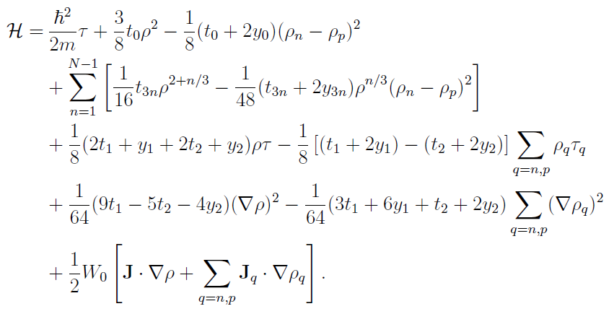
Transform the energy to Skyrme-force form and fit the additional parameters (t₁, y₁, t₂, y₂, W₀) to nuclear data
Skyrme type energy density functional
Critical point: Nuclear matter EoS is not affected by fitting to nuclear data

Slide 6
3. Fitting strategy
Keep the nuclear matter part unchanged (t₀, y₀, t_{3n}, y_{3n}: 7 parameters)
Start with smallest numbers: 2 parameters fitted to 6 nuclear data
Increase the number of parameters and data step-wisely
Consider the spherical nuclei only [KIDS-M0]: benchmarking PC-F1 and PC-PK1
Fitting parameters
P2: t₁, W₀ (assume t₂ ∝ t₁, y₁=y₂=0)
P3: [P2+] t₂
P4: [P3+] y₂
P5: [P4+] y₁

Slide 7
4. Result
★ Red numbers denote unsatisfactory results that trigger the next step
Fitting code | Nuclei | No. of data | RMSD(Mass) (MeV)
 |  |  | Input | 65 spherical nuclei | 630 nuclei
P2N3 | 40Ca, 48Ca, 208Pb | 6 | 0.159 |  | 4.287
P2N6 | [N3+] 16O, 90Zr, 132Sn | 12 | ? |  | 3.920
P2N7 | [N6+] 238U | 14 | 1.398 |  | 3.505
P3N7 | ↑ | ↑ | 0.915 |  | 3.476
At this moment we became aware of PC-F1 model
P3N17 | [N6+] 56Ni, 58Ni, 88Sr, 100Sn,112Sn, 120Sn, 124Sn, 136Xe, 144Sm, 202Pb, 214Pb (spherical: same to PC-F1) | 32 | 1.932
P4N17 | ↑ | 32 | 1.368 | 2.368 | 3.875
P4N30 | [N17+] 20Mg, 38Ca, 46Ca, 50Ca, 42Ti, 72Ni, 84Se, 122Sn, 126Sn, 130Sn, 134Sn, 200Pb, 218U (spherical) | 49 | 1.797 | 1.412 | 3.009
Similar to SLy4 but poor as a mass model

Slide 8
PC-F1, PC-PK1: Benchmark of KIDS-M0
Model | No. of parameters fitted to nuclear data | No. of input nuclei | RMSD(Mass) (MeV) 65 nuclei
PC-F1 | 11 | 17 | 2.604
KIDS-M0-P4N17 | 4 | 17 | 2.368
PC-PK1 | 11 | 60 | 1.329
KIDS-M0-P4N30 | 4 | 30 | 1.412

Slide 9
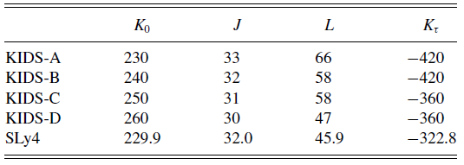
5. Summary
We started from an EDF that is consistent with neutron star observation
We worked out with as small number of parameters and data as possible
Systematic improvement of results has been demonstrated
P4N17 is better than PC-F1
P4N30 is close to PC-PK1
P5 and more nuclei input: As good as, or better than PC-PK1?
Dependence on the EoS: Now it is KIDS-B, next KIDS-D

