Slide 1
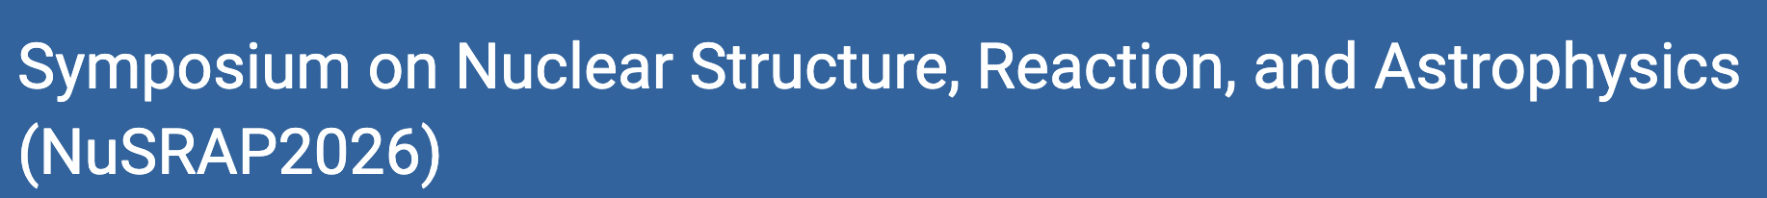
13-15 July 2026
Workshop Room
Center for Computational Sciences, University of Tsukuba, Tsukuba, Japan
Nuclear Scattering, Quantum Computing, and SQD:
Toward Noise-Resilient Spectral Calculations on Quantum Hardware
IonQ-compatible rodeo filtering + sample-based quantum diagonalization
Jubin Park
Soongsil University / OMEG Institute
with Dr. Myeong-Hwan Mun and Prof. Myung-Ki Cheoun
Title
Notes:
Open with the problem: scattering is continuum physics, but QPUs naturally give finite spectral data. The talk is about a validation protocol, not yet a claim of new np phase shifts.

Slide 2
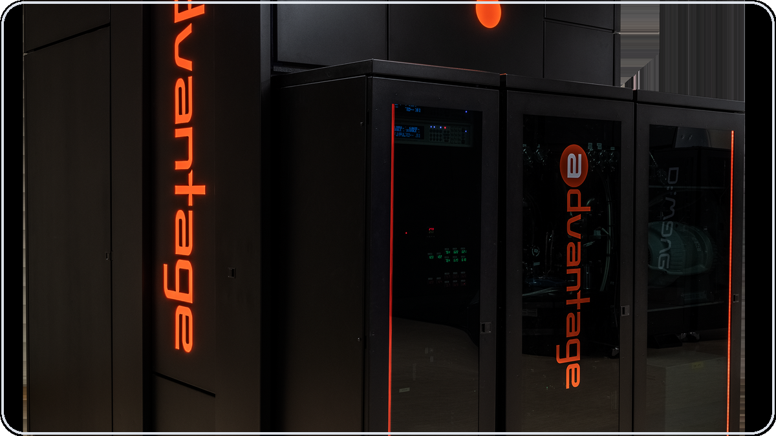
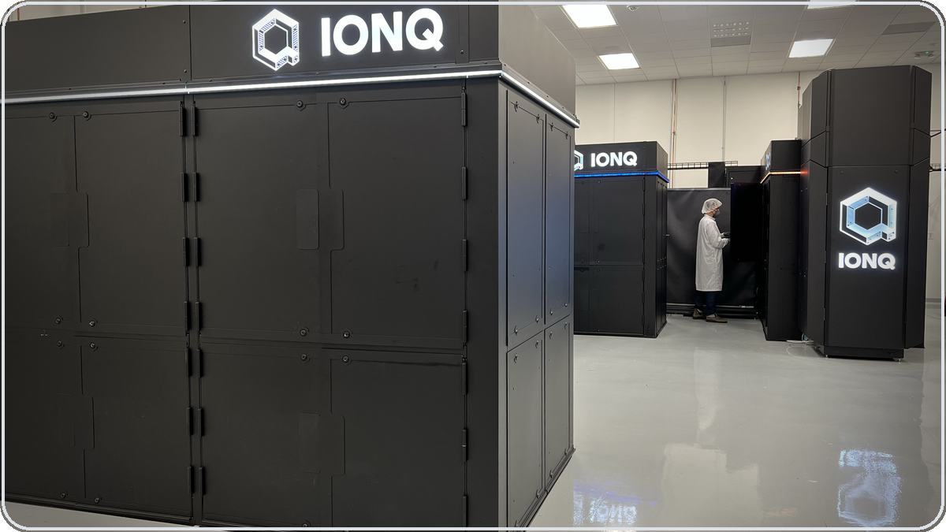
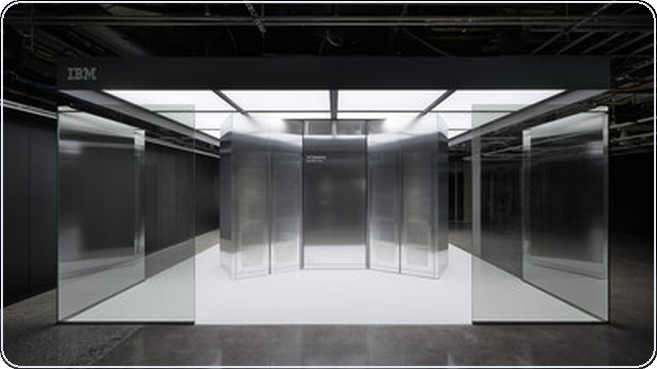
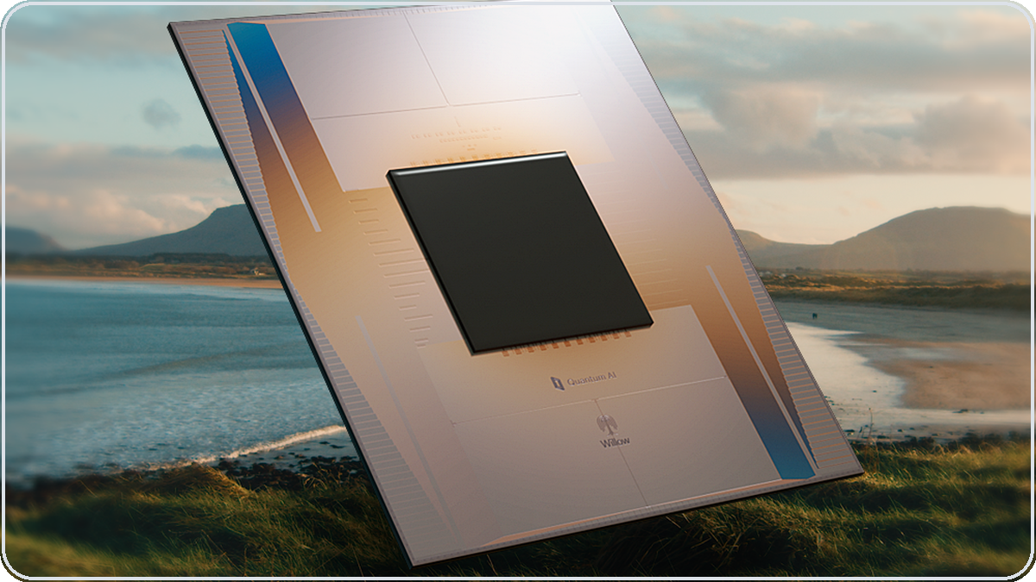
HARDWARE CONTEXT
Quantum computers are not one category
Start by separating annealers from universal gate-model QPUs.
Quantum annealer
Universal gate-model QPU
Special-purpose energy minimizer for QUBO / Ising-type optimization landscapes.
Circuit machine for arbitrary unitary algorithms: controlled time evolution, phase estimation, rodeo filtering, VQE/QSE/SQD.
IonQ Forte
trapped ions
IBM Heron
superconducting
Google Willow
superconducting
Rodeo filtering needs controlled U(t) and a measurable ancilla register.
That places this nuclear-scattering benchmark in the gate-model class.
D-Wave Advantage2
4,400+ annealing qubits
Sources: D-Wave Advantage2 official release; IonQ Forte product page; IBM Quantum hardware page; Google Quantum AI Willow page/spec sheet.

Slide 3
HARDWARE CONTEXT
Annealer vs gate-model QPU: what is being computed?
D-Wave is not a worse/better IonQ; it is a different computational model.
Quantum annealer
Gate-model QPU
Native object
Energy landscape, usually Ising/QUBO
Native object
Quantum circuit with gates and measurements
Strength
Large combinatorial optimization and hybrid heuristics
Strength
Programmable algorithms: U(t), QPE, VQE, QSE, SQD, rodeo
Connectivity
Graph topology optimized for embedding
Connectivity
Device dependent; IonQ is all-to-all, superconducting chips are usually local
For this work
Not suitable for the controlled-time-evolution rodeo circuit
For this work
Required model for ancilla-controlled spectral filtering
For the nuclear-scattering benchmark, the deciding requirement is not qubit count; it is the ability to implement controlled e^{-iHt} and scan E_q.
D-Wave describes quantum annealing as a process to find low-energy states of an optimization problem; gate-model QPUs execute programmable circuits.

Slide 4
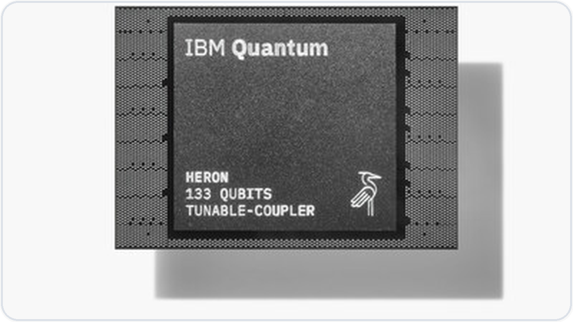
HARDWARE CONTEXT
Representative platforms at a glance
Annealer
Trapped ions
Superconducting
Superconducting
D-Wave Advantage2
IonQ Forte
IBM Heron
Google Willow
4,400+ annealing qubits
Zephyr 20-way connectivity
Optimization / QUBO focus
36 qubits
all-to-all topology
compact dense circuits
133/156 qubits
tunable couplers
fast circuit execution
105 qubits
QEC benchmark
research processor
Best comparison axis:
application fit, not raw qubit count
Best comparison axis:
application fit, not raw qubit count
Best comparison axis:
application fit, not raw qubit count
Best comparison axis:
application fit, not raw qubit count
For this rodeo/SQD workflow, IonQ is attractive because the Hamiltonian is dense and compact; D-Wave is a different model, not an alternative rodeo backend.

Slide 5
Toward QPU Calculations of Nuclear Scattering
via
Trapped Positive-Energy Spectra

Slide 6
The one-sentence message
A near-term QPU calculation of nuclear scattering should be judged by nuclear error diagnostics, not just by whether a circuit runs.
1. Peak-center stability
2. SQD subspace completeness
3. Phase-shift uncertainty
Does the fitted trapped level remain stable?
Do sampled bitstrings span the Hamiltonian-connected subspace?
How does ΔE propagate to the scattering observable?
This talk builds that benchmark for trapped n–p scattering and shows where SQD is powerful — and where it fails.
main point
Overview

Slide 7
Elastic scattering probes the positive-energy Hamiltonian
Bound states
Scattering states
Discrete spectrum; localized wave functions; easier boundary conditions.
Continuum boundary conditions; threshold behavior; phase shifts.
Why we care
•
Low-energy cross sections and reaction rates
The quantum-computing task must therefore return a controlled nuclear observable — not just a circuit success signal.
•
Weakly bound and continuum-coupled nuclear systems
•
Same short-range correlations that shape spectra
Motivation

Slide 8
Near-term QPUs do not naturally prepare asymptotic waves
Continuum
scattering state
Outgoing-wave
boundary condition
Phase shift
δ(E)
Difficult on current devices:
Opportunities:
•
No direct asymptotic-state preparation
•
Real-time evolution is native to quantum algorithms
•
Continuum normalization is not a finite-register object
•
Spectral filtering can locate discrete levels
•
Readout gives bitstrings; scattering needs phase shifts
•
Finite trapped spectra can be mapped back to scattering
Motivation

Slide 9
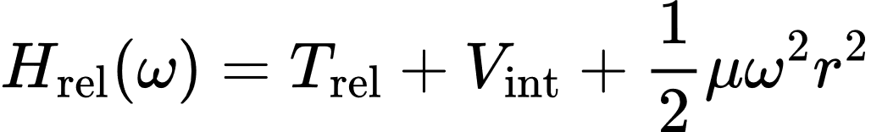
The weak-trap compromise: continuum → finite spectrum
Free-space
scattering
Weak
harmonic trap
Discrete positive-
energy levels
The QPU target is now a finite spectral task:
Find the trapped positive-energy eigenlevel accurately enough to infer the phase shift.
Motivation

Slide 10
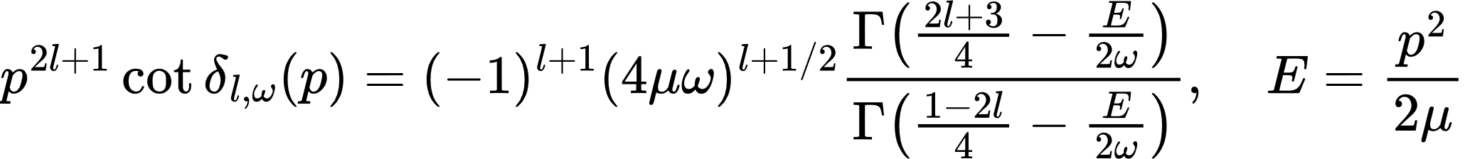
MERE (Modified effective range expansion) links levels to phase shifts
The key point for hardware:
Required QPU output
Not required
Validation
A trapped level E with uncertainty ΔE
An asymptotic scattering wave function
Propagate ΔE to Δδ or Δ[p^{2l+1}cotδ]
This makes peak-center accuracy, rather than raw visibility, the nuclear figure of merit.
Motivation

Slide 11
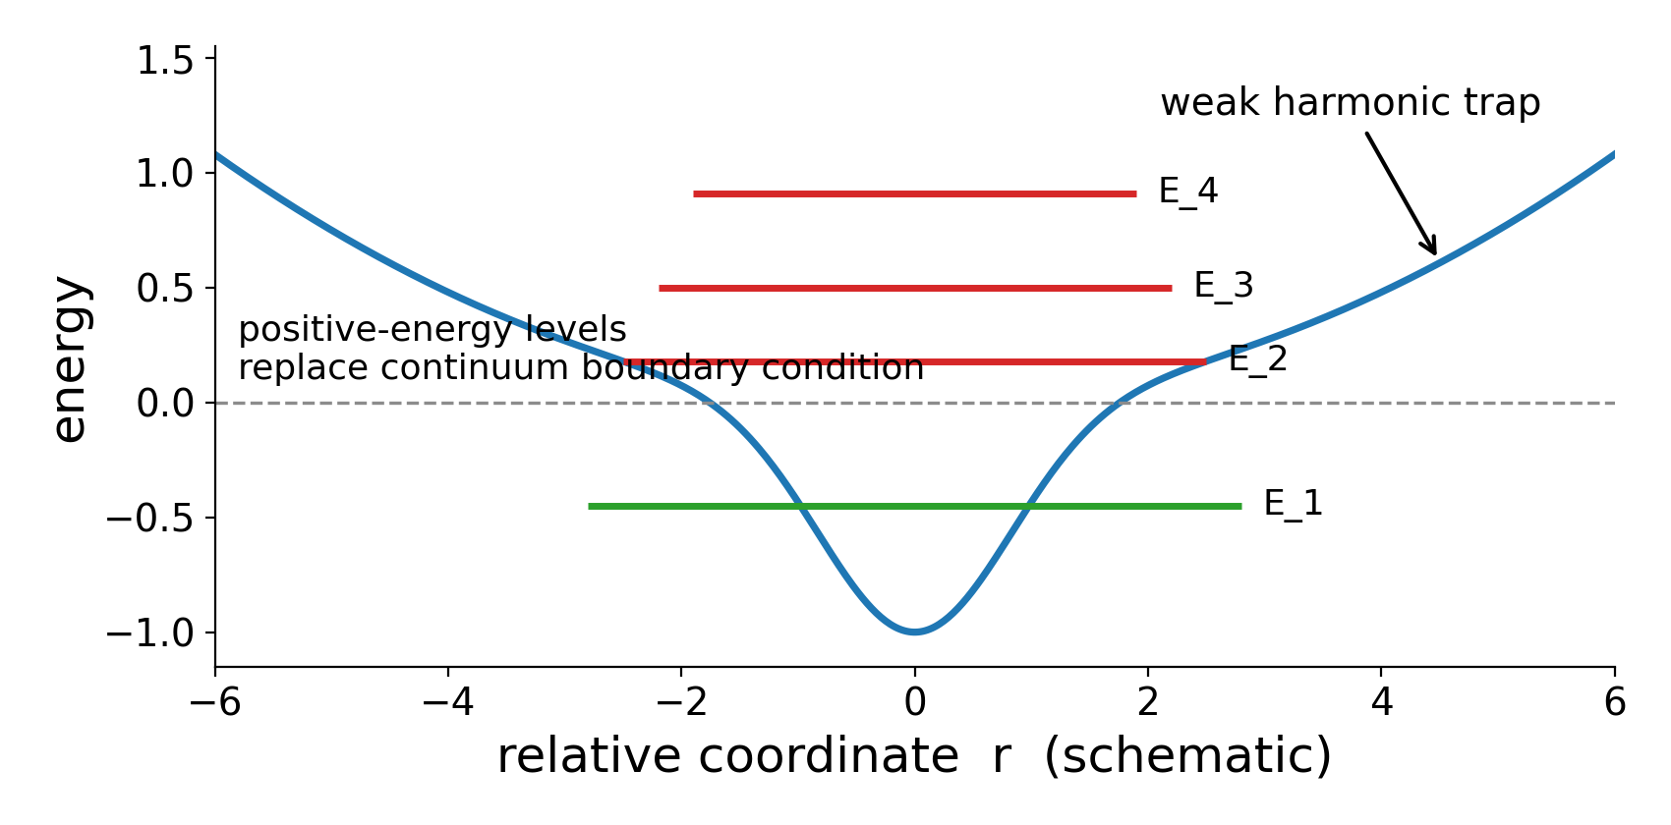

MERE: one trapped level becomes one scattering datum
For an s-wave, the weak-trap level is converted into a value of p cot δ.
Step-by-step
1. Measure or fit a trapped level E at trap frequency ω
2. Compute p from E = p²/(2μ)
3. Insert E and ω into the gamma-function ratio
4. Obtain one finite-trap point p cot δ0,ω
Important distinction
This is not yet the final free-space phase shift. A single trapped level gives one finite-trap scattering datum. A controlled phase-shift curve requires several levels and several trap frequencies, followed by extrapolation.
MERE: Luu et al. PRC 82, 034003 (2010); Zhang PRC 101, 051602(R) (2020); Wang et al. PRC 109, 064623 (2024)
Notes:
MERE 식은 이 발표의 핵심입니다. 약한 harmonic trap이 continuum을 discrete positive-energy level로 바꾸고, 그 level 하나가 p cot delta라는 scattering datum 하나로 변환됩니다. 하지만 한 점만으로는 phase shift curve가 되지 않는다는 점을 강조하세요.

Slide 12
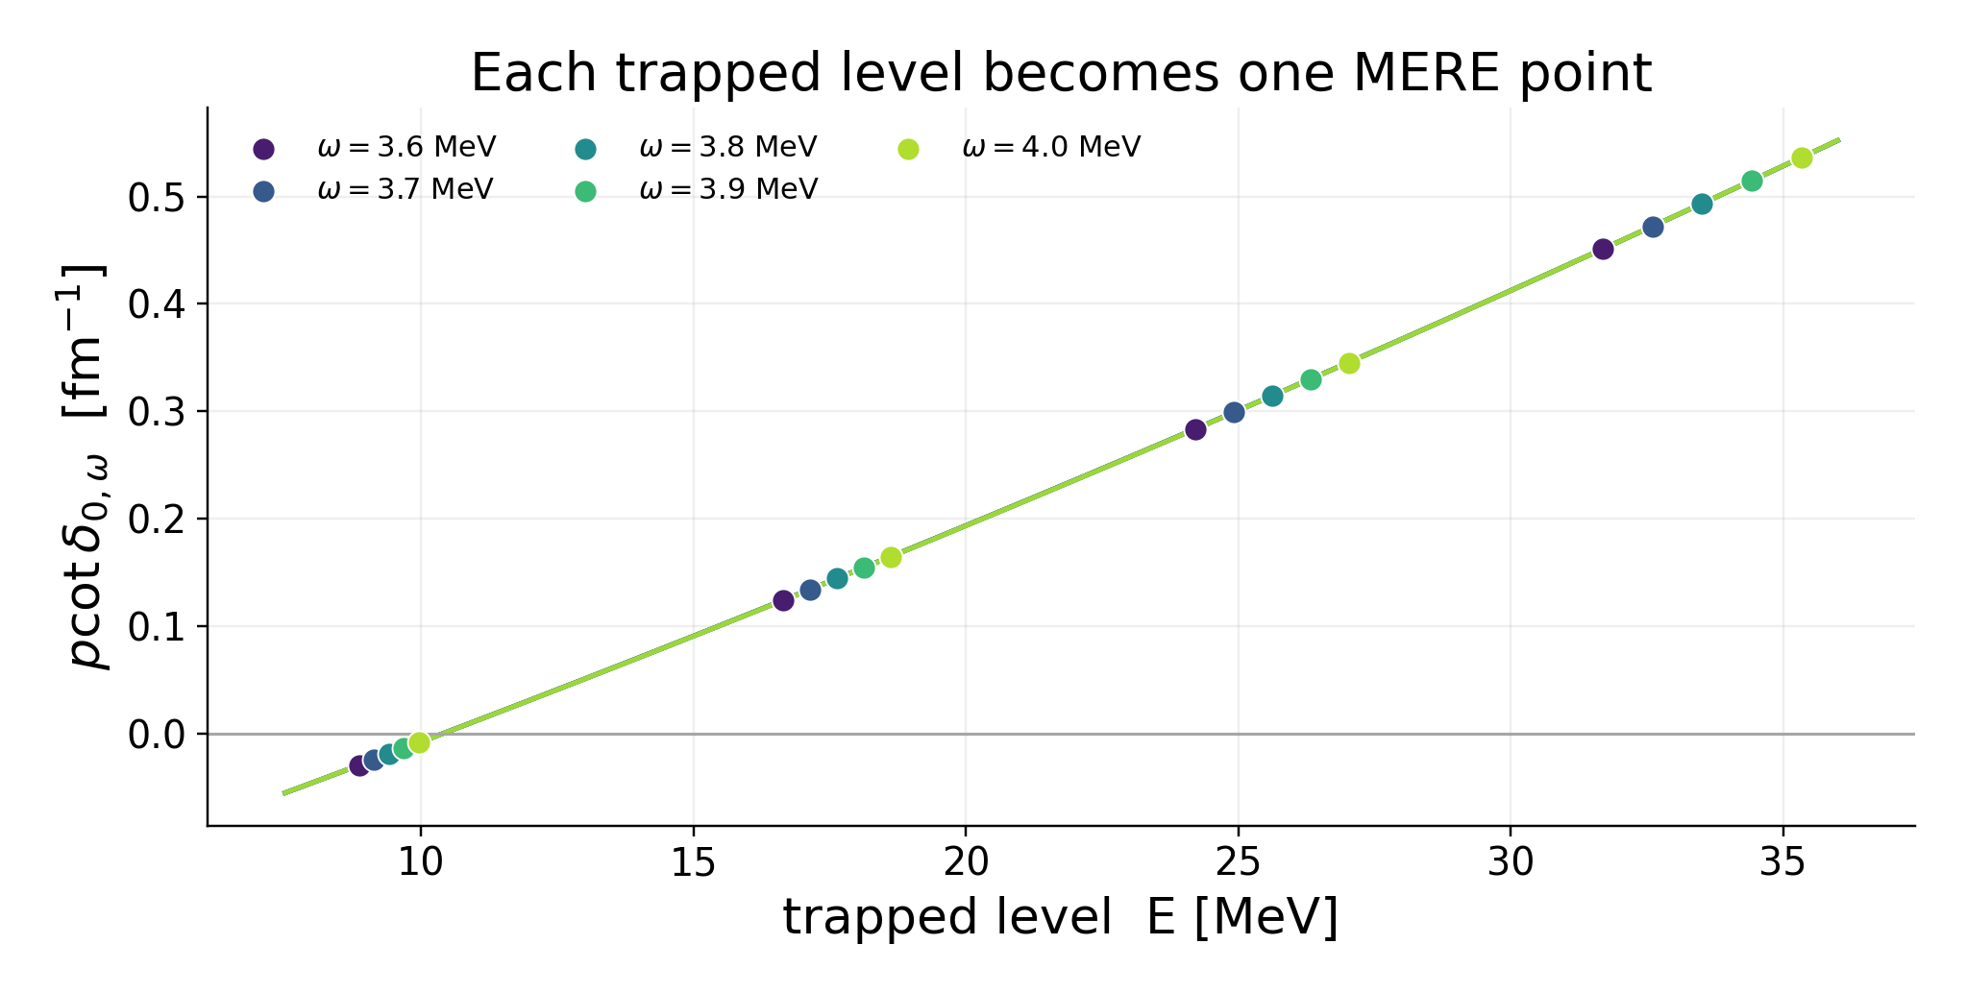

Extrapolation is a fit, not a single conversion
The free-space phase shift is reconstructed from a family of trapped levels.
At fixed trap strength ω
Fit p cot δ0,ω as a smooth function of energy using the trapped levels.
At fixed scattering energy E
Extrapolate p cot δ0,ω in ω² to obtain the free-space value.
Then compute the phase shift
For the s-wave: δ0 = atan2(p, p cot δ0). The branch is chosen continuously so that the physical phase shift is obtained.
MERE: Luu et al. PRC 82, 034003 (2010); Zhang PRC 101, 051602(R) (2020); Wang et al. PRC 109, 064623 (2024)
Notes:
여기서 강조할 점은 phase shift를 구하려면 여러 trap frequency와 여러 trapped level이 필요하다는 것입니다. 우리 E2 single-level benchmark는 energy extraction의 검증이고, 완전한 phase-shift 계산은 다중 level/trap table이 필요합니다.

Slide 13
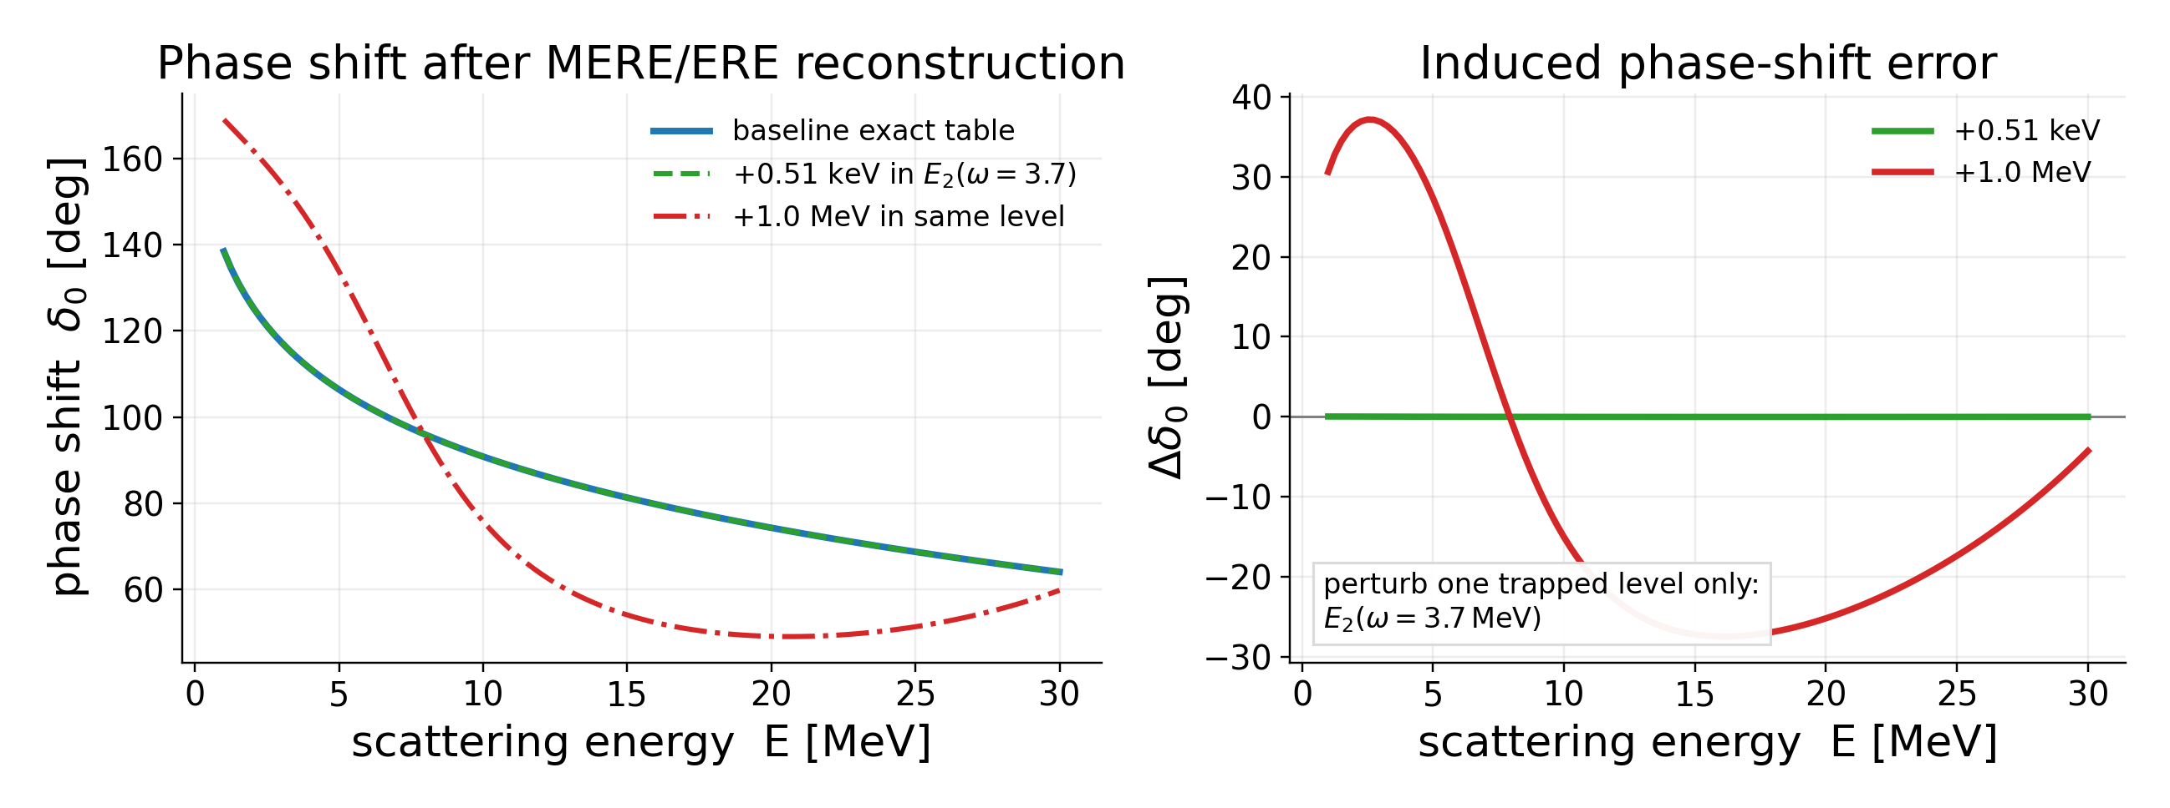
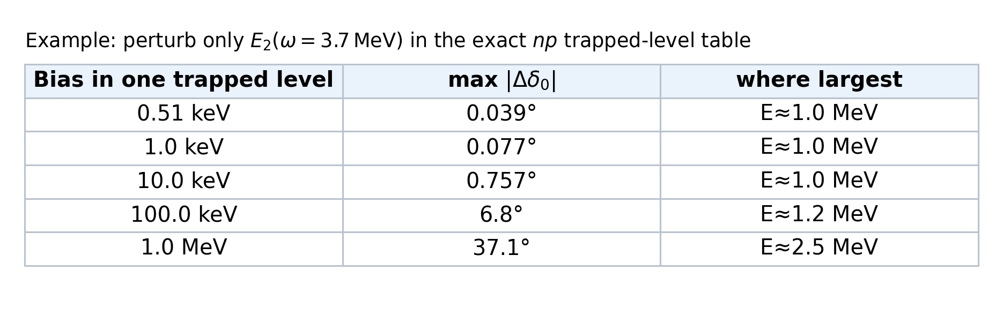
Actual sensitivity test for the np trapped-level table
Perturb one input level, then redo the same MERE/ERE reconstruction.
What was perturbed?
Only the trapped level E₂ at ω = 3.7 MeV was shifted; all other exact table entries were kept fixed.
Numerical lesson
A +0.51 keV energy bias induces < 0.04° in this test. A +1 MeV error can induce tens of degrees.
Use this carefully
This is a one-level perturbation study, not a full covariance analysis.
MERE: Luu et al. PRC 82, 034003 (2010); Zhang PRC 101, 051602(R) (2020); Wang et al. PRC 109, 064623 (2024)
Notes:
이 슬라이드는 실제 숫자가 들어간 핵심 슬라이드입니다. 우리 noisy simulator의 peak-center bias인 0.51 keV는 이 sensitivity test에서는 최대 0.04도 정도입니다. 반대로 MeV급 SQD subspace bias는 phase shift를 크게 망가뜨릴 수 있습니다.

Slide 14
Benchmark: two-qubit OLS effective Hamiltonian
System: trapped neutron–proton scattering, ω = 3.7 MeV
Two qubits mean four basis states:
Target trapped level:
level
energy [MeV]
Purpose of this compact benchmark:
E1
9.12955079
•
Not a scalability claim
E2
17.13403932
E3
24.91608217
•
A controlled test of encoding, fitting, postselection, and SQD
E4
32.60210525
•
Exact answer is known for hardware validation
Circuit

Slide 15
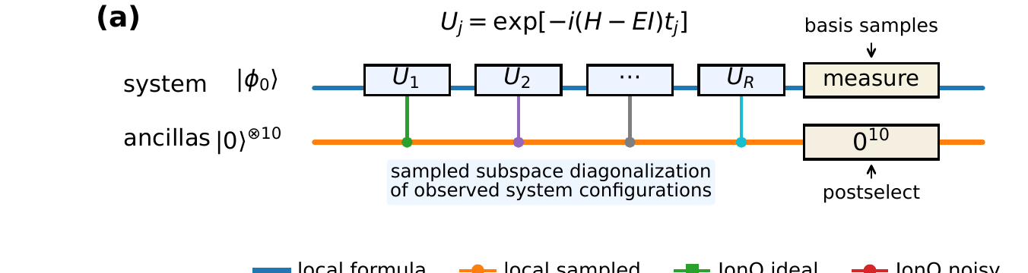
Rodeo-style energy filtering
•
Choose a query energy E
If E is close to an eigenvalue, the all-ancillas-zero outcome is enhanced.
•
Repeat R times
Here R = 10 static ancillas are used for cloud compatibility.
•
Scan E
The same accepted shots also contain the system-register bitstrings used for SQD.
The spectral peak center estimates the trapped eigenlevel.
Circuit

Slide 16
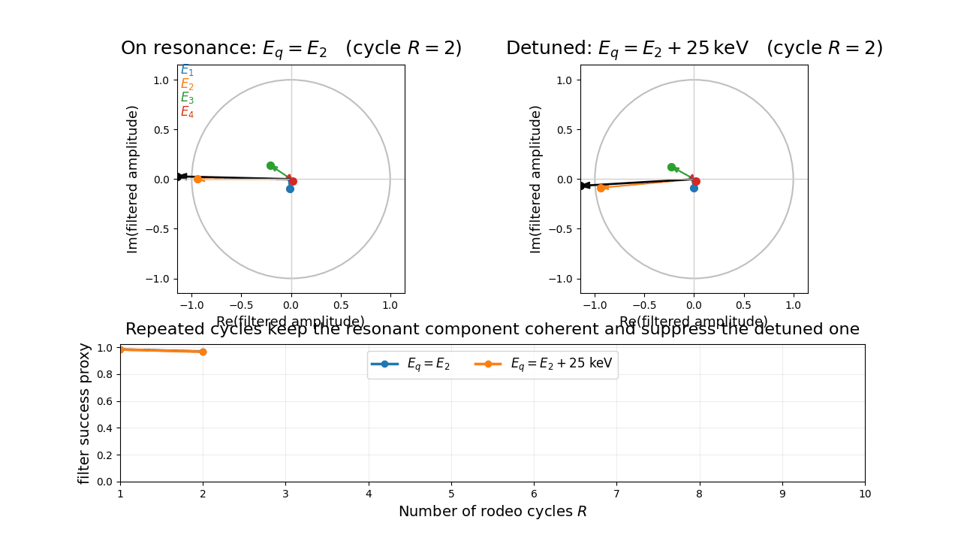
Rodeo filter intuition: what the ancillas are testing
Compact intuition slides for insertion near the rodeo-filter section
One rodeo cycle multiplies each eigencomponent by
f_n(t; E_q) = [1 + exp(-i (E_n - E_q) t)] / 2
= exp[-i Δ_n t / 2] cos(Δ_n t / 2)
If the query energy E_q is near an eigenenergy E_n, the cosine stays near 1 and the phase remains coherent.
If E_q is far from E_n, both the phase and the cosine oscillate, so repeated cycles suppress that component.
Conditioning on all ancillas = 0 therefore acts like an energy filter centered on E_q.
Scanning E_q turns this filter into a trapped-level peak that can be fitted for the peak center E_c.
Preview: on resonance the target component stays locked,
while off-resonant components dephase and shrink.

Slide 17
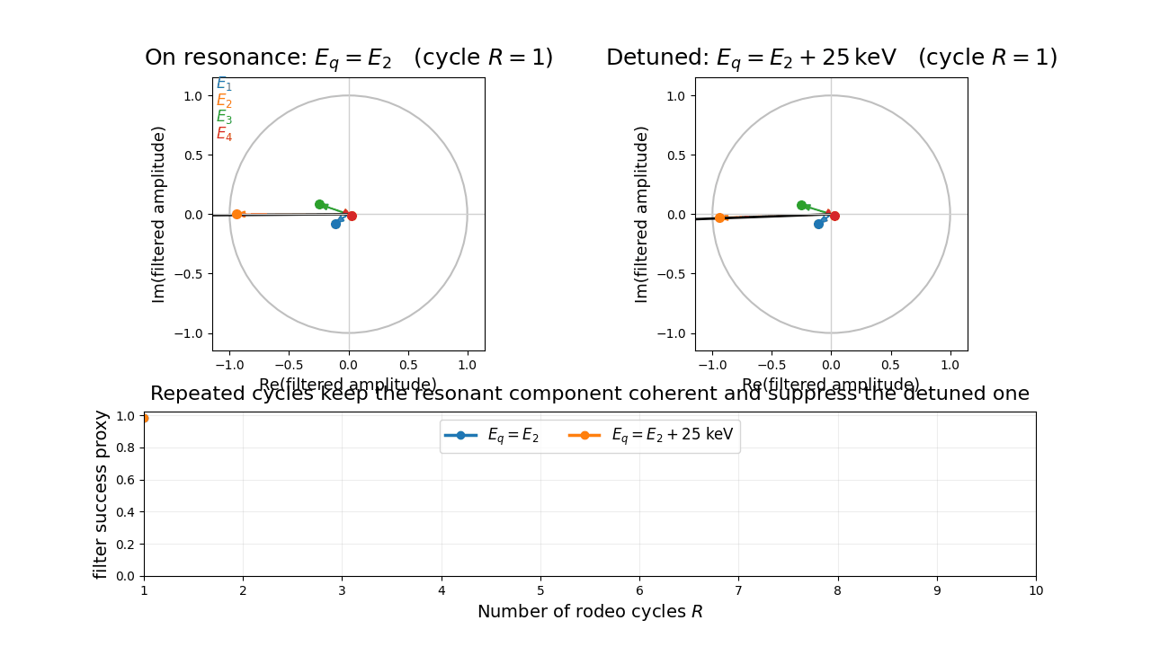
Animation 1: resonance locks phase, off-resonant pieces dephase
Left panel: E_q = E_2 (on resonance).
Right panel: E_q = E_2 + 25 keV (detuned).
Colored arrows show filtered eigencomponents; the black arrow is the total filtered amplitude.
Bottom: a simple success-probability proxy versus the number of rodeo cycles R.
Main idea: resonance keeps the target piece coherent, while non-resonant pieces wander and cancel.

Slide 18
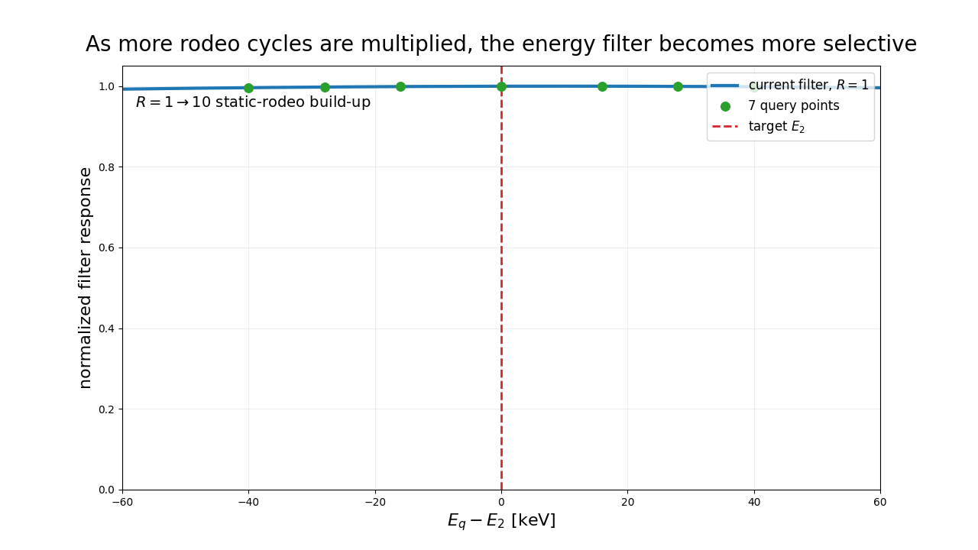
Animation 2: more rodeo cycles sharpen the energy filter
Each extra rodeo cycle multiplies another filtering factor into the response.
As R grows, the response becomes more selective around the target E_2.
The 7 green markers are the actual reduced query offsets used in the compact E_2 scan.
This is the intuition behind turning a short E_q scan into a visible trapped-level peak.

Slide 19
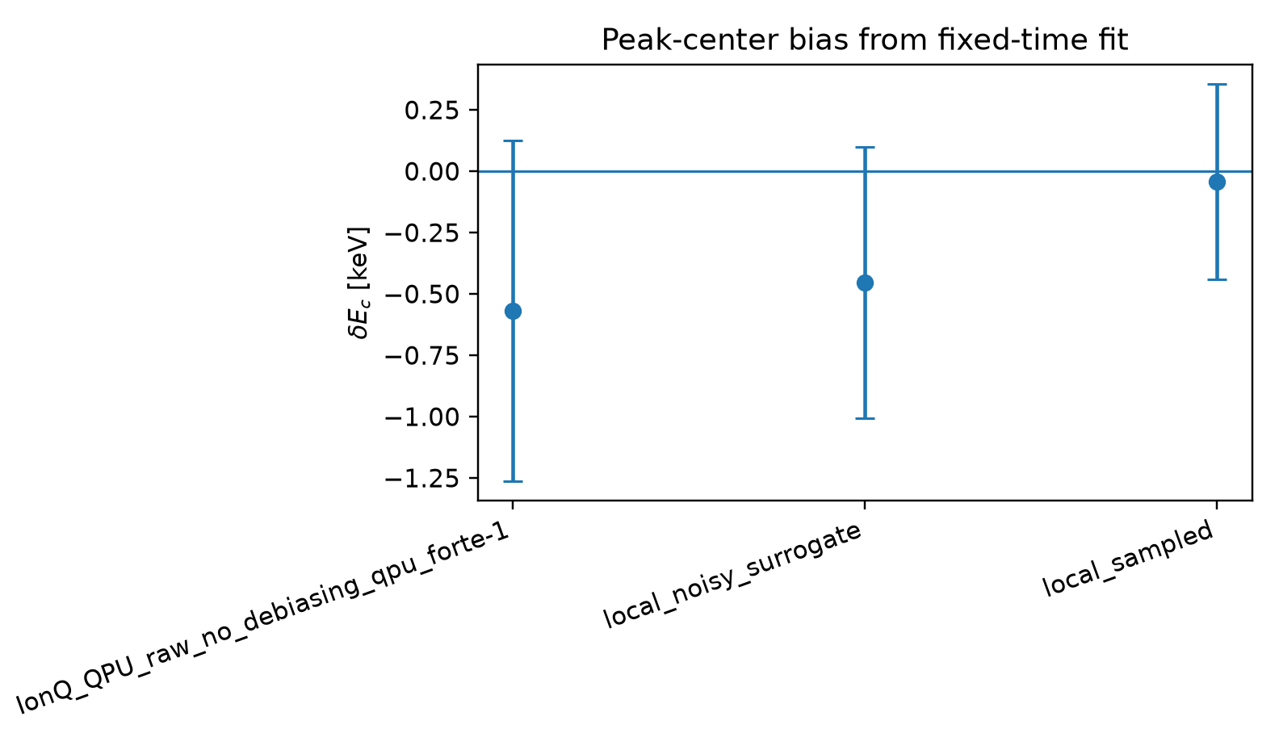
Take-home message for the talk: what rodeo filtering buys us
Rodeo filtering converts a difficult positive-energy scattering problem into a trapped-level peak-finding problem.
The all-ancillas-zero event is not just postselection; it is the energy filter that favors components near the query energy.
For hardware validation, the important nuclear diagnostic is the fitted peak center E_c, not the absolute peak height.
Our actual Forte-1 result shows exactly this: delta E_c = -0.568 ± 0.694 keV, even though the peak amplitude is attenuated to K/K_local = 0.548.

Slide 20
Actual QPU execution
Forte-1 raw no-debiasing E₂ rodeo scan is now completed.
QPU result: δEc = −0.568 ± 0.694 keV • K/Klocal = 0.548 • 7 circuits × 500 shots
QPU results
29
Notes:
Open this section by saying the QPU part is no longer a plan. We now have one completed Forte-1 raw no-debiasing 7-point E2 scan. The main result is center stability within bootstrap uncertainty plus clear amplitude attenuation.

Slide 21
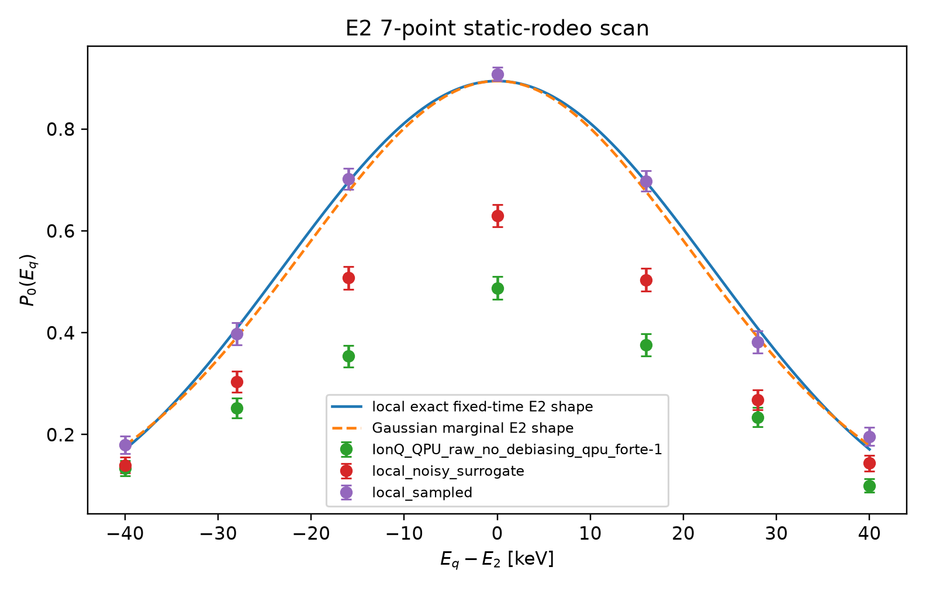
Forte-1 QPU resolves the E₂ rodeo peak, with strong attenuation
Primary fitted center
δEc = −0.568 keV
bootstrap σ = 0.694 keV
Amplitude monitor
K/Klocal = 0.548
raw no-debiasing QPU
Fit quality
χ²/dof = 2.10
shape distortion present, center stable
What to say
The QPU points are vertically suppressed, but the peak center remains consistent with E₂ within 1σ. This is the favorable noise mode for the trapped-spectrum task.
Primary fit uses the fixed-time line shape because the hardware used one archived set of R=10 rodeo times.
QPU results
31
Notes:
Do not sell this as a high-visibility peak. Sell it as a controlled peak-center measurement. The important point is that the amplitude loss is separated from the nuclear energy input.

Slide 22
Nuclear diagnostic: peak-center bias, not peak height
Fixed-time fit summary
backend
δEc [keV]
σboot [keV]
Forte-1 QPU raw
−0.568
0.694
noisy surrogate
−0.454
0.553
local sampled
−0.044
0.398
Validation status
PASS: |δEc|/σboot = 0.82
Interpretation: the QPU peak shape is imperfect, but the extracted trapped level is statistically consistent with the exact OLS E₂ reference.
Gaussian cross-check: δEc = −0.523 ± 0.724 keV, giving the same conclusion.
Eref = 17.1340393176 MeV; uncertainties from bootstrap resampling of finite-shot probabilities.
QPU results
32
Notes:
This is the central slide. The line at zero means the exact E2 reference. The QPU error bar includes zero, so the nuclear spectral input passes the validation test.

Slide 23
Conclusions
•
Trapped spectra make nuclear scattering QPU-accessible
The QPU target is a finite positive-energy eigenlevel.
•
Noisy simulator primarily attenuates the signal
Forte-1 noisy: K/Kloc = 0.303, Pmax = 0.183, but peak-center bias ≈ 0.51 keV.
•
SQD can exactly recover the 4×4 result
Only because the sampled support spans the full effective space.
•
Larger diagnostics reveal the limitation
Missing H-connected configurations can cause MeV-scale SQD bias.
•
Validation standard
Stable peak center + complete sampled subspace + phase-shift uncertainty propagation.
The quantum-computing task must therefore return a controlled nuclear observable — not just a circuit success signal.
Conclusions

Slide 24
Thank you
Questions and discussion
Three diagnostics to remember
peak center • SQD support • phase-shift uncertainty
Discussion

