Slide 1
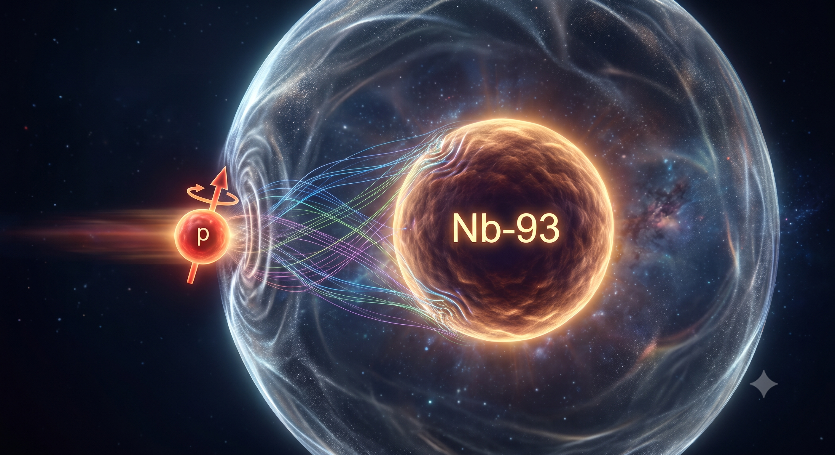

Spin-dependent nucleon-nucleus
interactions constrained by neutron observables and their impact on
near-barrier proton fusion
Kyoungsu Heo, et al. arXiv:2605.26561 [nucl-th]
Kyoungsu Heo (Soongsil Univ.)
炅修 許
Collaborator:
Prof. M. K. Cheoun (Soongsil Univ.)
Prof. K. Hagino (Kyoto Univ.)

Slide 2
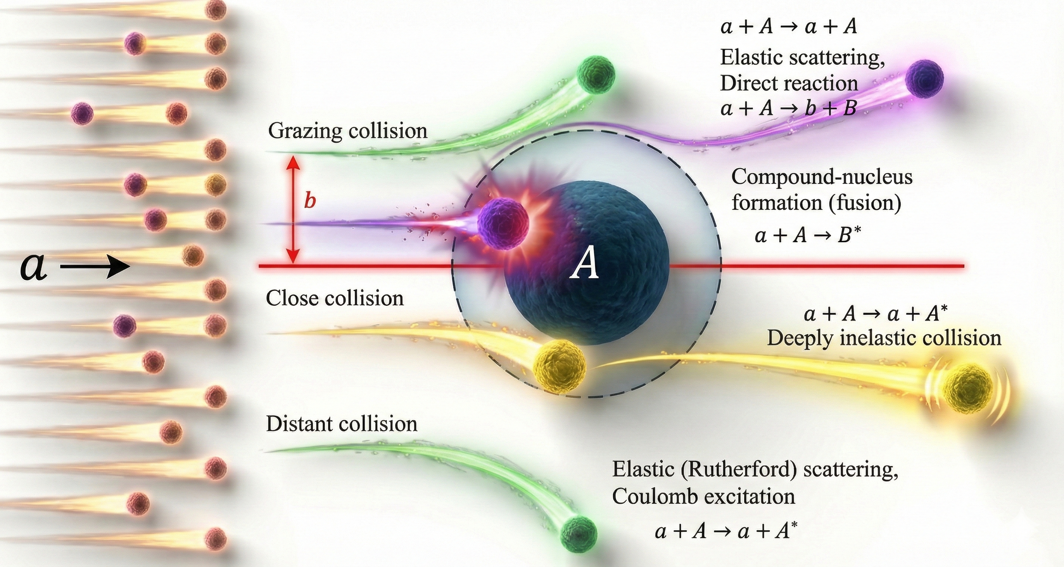

Slide concept by G. R. Satchler Book
Types of reactions (in low-energy)
Kouichi Hagino
Dahee Kim AND S.Ando
Hiroshi Watanabe
Made in Gemini
$$∗b=\frac{l}{k}=\frac{D_{0}}{2}cot\frac{θ}{2}, { D}_{0}=\frac{Z_{1}Z_{2}e^{2}}{E_{c.m.}}$$

Slide 3
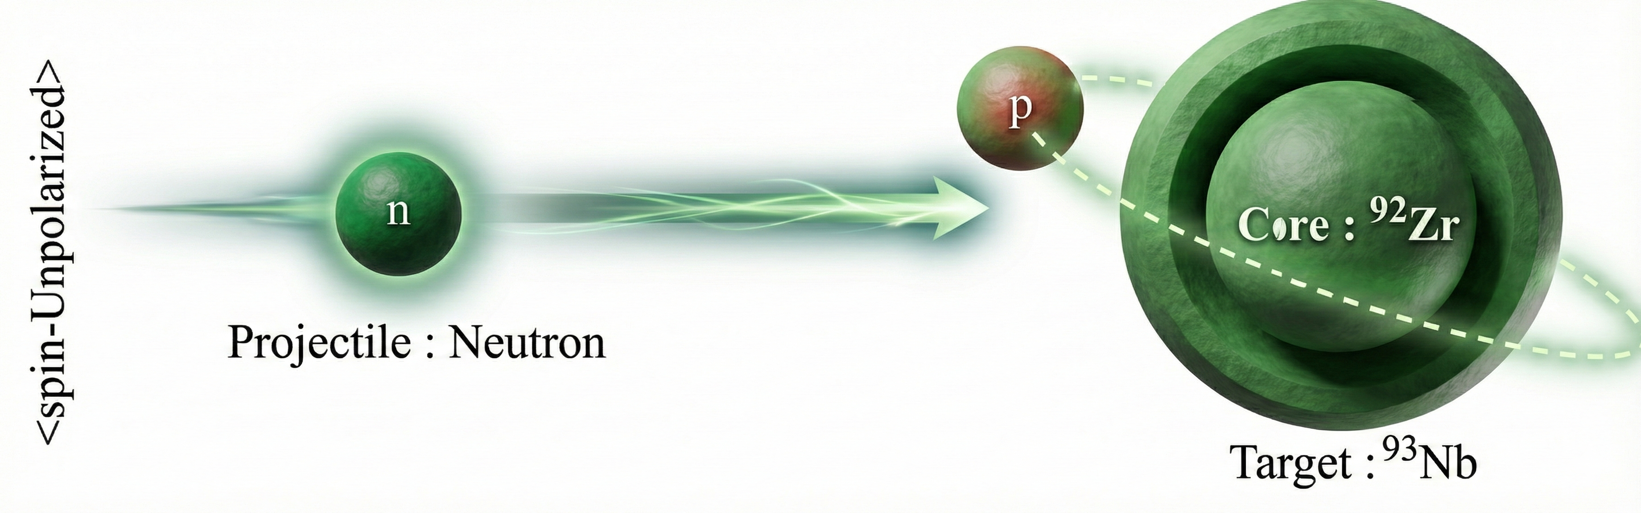
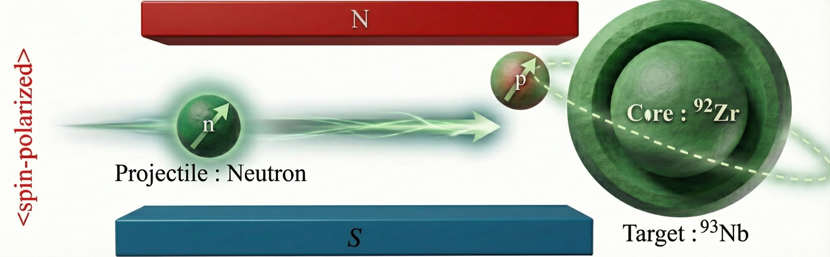
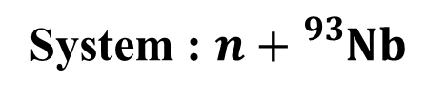

System : $n+{}_{}^{93}{Nb}$
Spin-dependent nucleon-nucleus scattering
$( J^{π}={\frac{9}{2}}^{+})$

Slide 4
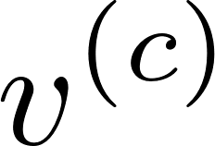
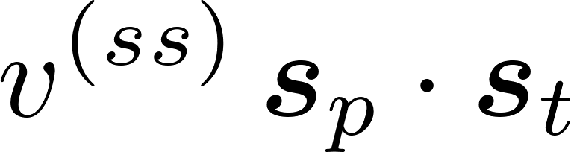
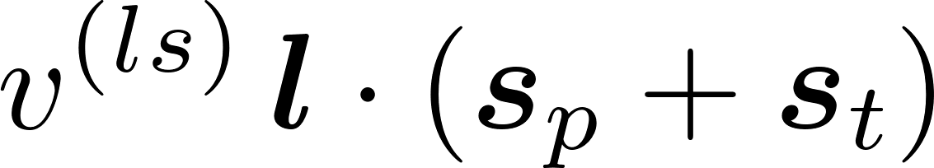
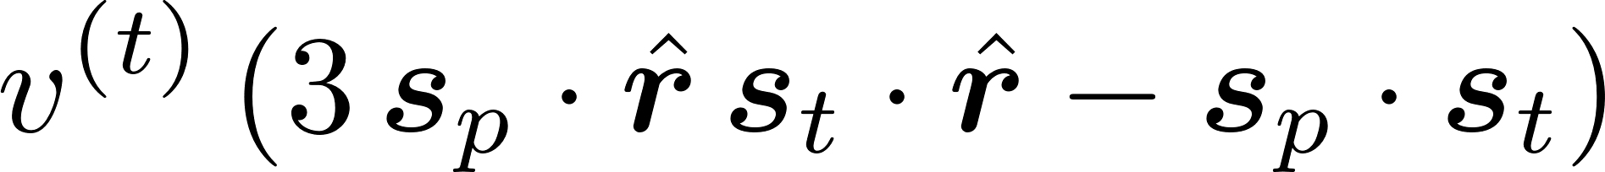
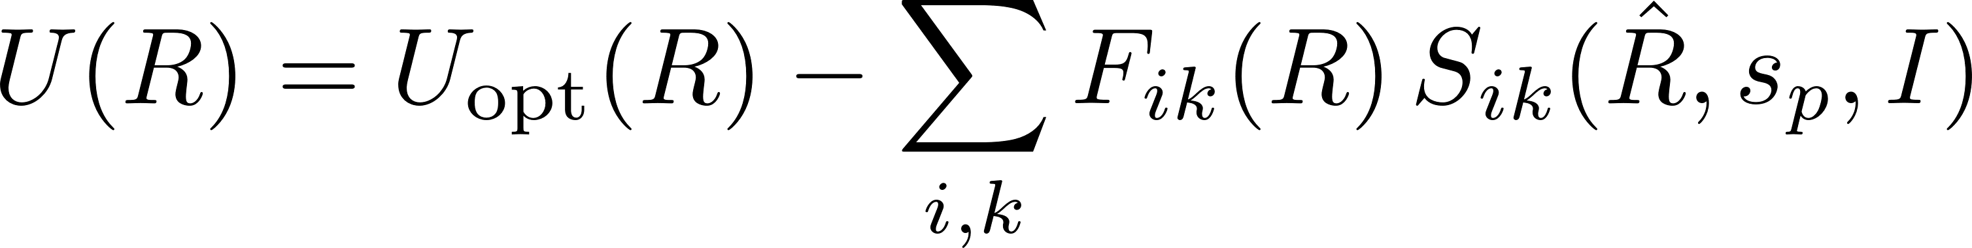

Spin-Spin interaction for nucleon-nucleus scattering
$$F_{ik}\sim \int_{0}^{∞}{dr_{t}u_{l_{t}}^{2}\left(r_{t}\right)v(R,αr_{t})}$$
The spin expansion of the nucleon-nucleon interaction as
: Central part (Spin-independent) : CH89 (global optical model potential)
: Spin – Spin part (Spin-dependent)
: Spin – Orbit part (Spin-dependent) : $l∙σ$
: Tensor part (Spin-dependent)
Effective n-n interactions : M3Y, T4Y …

Slide 5
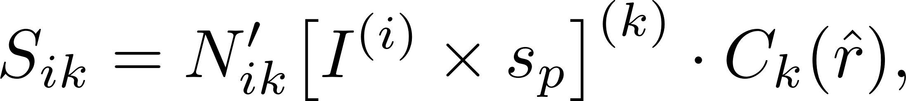
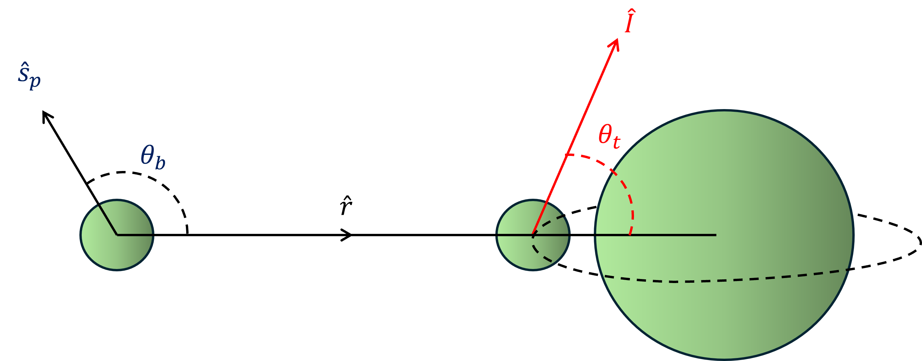
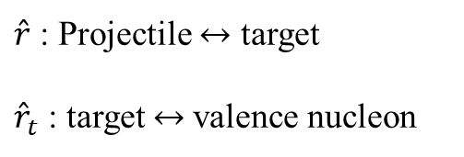
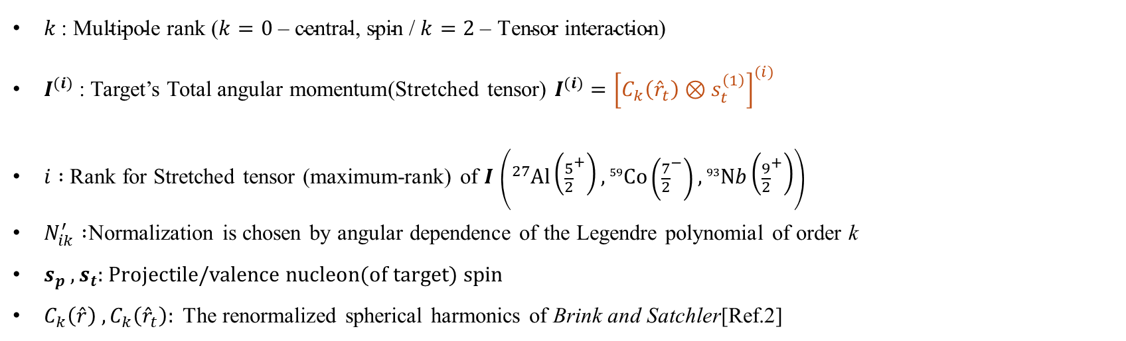
Ref.1 : T.L McABEE (NPA A509(1990)39-79)
Ref.2 : Angular momentum (1971)
The spin-spin operator $S_{ik}$ - [Ref.1]
$\hat{r}$ : Projectile $↔$ target
${\hat{r}}_{t}$ : target $↔$valence nucleon
< Proj. - Nucleon >
< Odd –Target >
$k \text{: }\text{Multipole} \text{rank}\text{ (}k=0\text{ – }\text{central}\text{, }\text{spin}\text{ / }k=2\text{ – }\text{Tensor} \text{interaction}\text{)}$
$I^{(i)}$ : Target’s Total angular momentum(Stretched tensor) $I^{(i)}={\left[C_{k}\left({\hat{r}}_{t}\right)⊗s_{t}^{\left(1\right)}\right]}^{(i)}$
$i :$ Rank for Stretched tensor (maximum-rank) of $I$ $\left({}_{}^{27}{Al}\left({\frac{5}{2}}^{+}\right),{}_{}^{59}{Co}\left({\frac{7}{2}}^{−}\right),{}_{}^{93}{Nb}\left({\frac{9}{2}}^{+}\right)\right)$
$N_{ik}^{′} :$Normalization is chosen by angular dependence of the Legendre polynomial of order k
$s_{p} ,s_{t}:$ Projectile/valence nucleon(of target) spin
$C_{k}\left(\hat{r}\right) ,C_{k}\left({\hat{r}}_{t}\right):$ The renormalized spherical harmonics of Brink and Satchler[Ref.2]

Slide 6
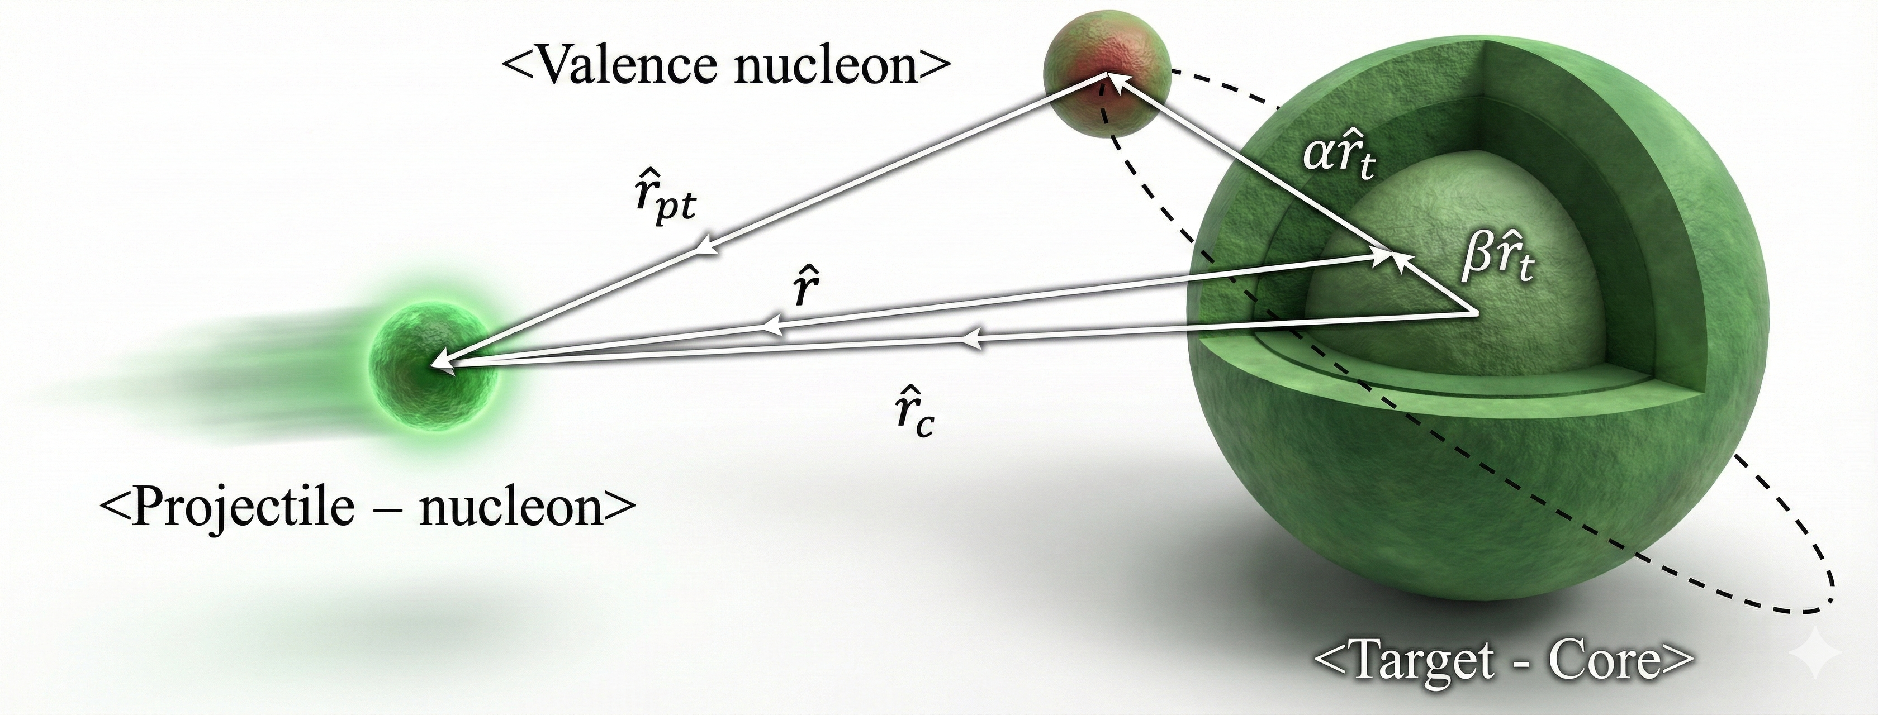
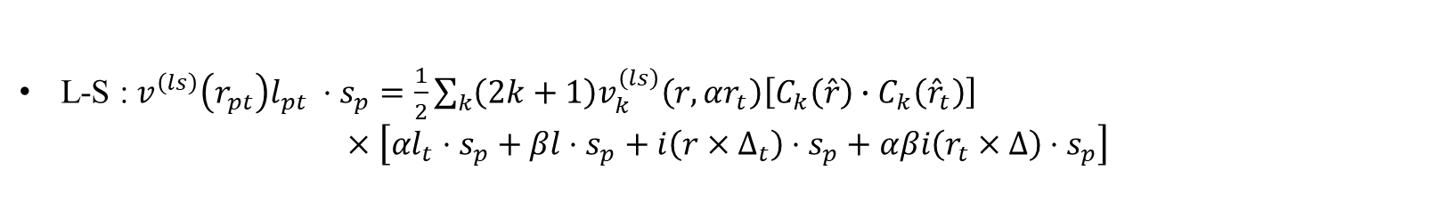
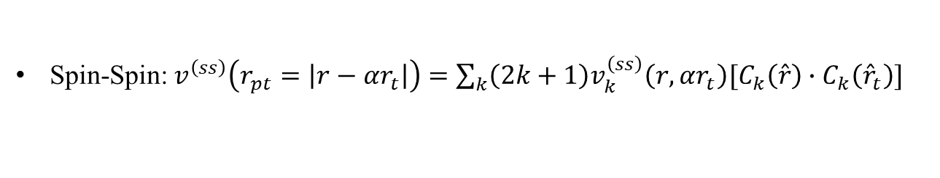
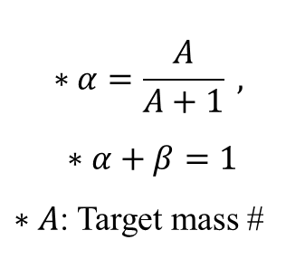
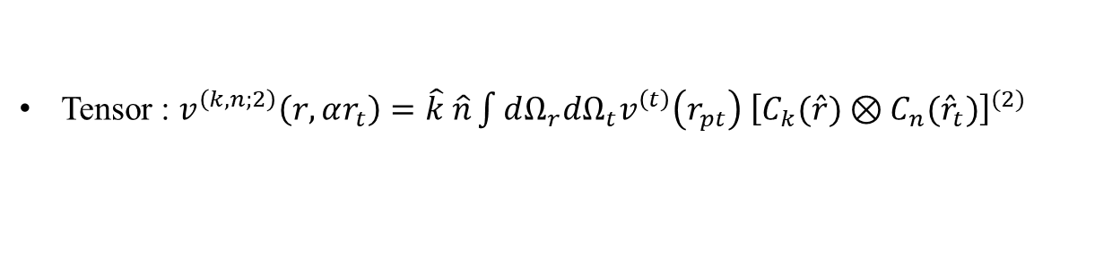
Exchange approximation
Multipole expansion of the NN radial kernel
$$∗α=\frac{A}{A+1} ,$$
$$∗α+β=1$$
$∗A$: Target mass #
Spin-Spin:$v^{\left(ss\right)}\left(r_{pt}=\left|r−{αr}_{t}\right|\right)=\sum_{k}{\left(2k+1\right)v_{k}^{\left(ss\right)}\left(r,αr_{t}\right)[C_{k}\left(\hat{r}\right)∙C_{k}\left({\hat{r}}_{t}\right)]}$
Tensor : $v^{\left(k,n;2\right)}\left(r,αr_{t}\right)=\hat{k} \hat{n}\int{dΩ_{r}dΩ_{t}v^{\left(t\right)}\left(r_{pt}\right)}$ ${\left[C_{k}(\hat{r})⊗C_{n}({\hat{r}}_{t})\right]}^{(2)}$
L-S : $v^{\left(ls\right)}\left(r_{pt}\right)l_{pt} ⋅s_{p}=\frac{1}{2}\sum_{k}{\left(2k+1\right)v_{k}^{\left(ls\right)}\left(r,αr_{t}\right)\left[C_{k}\left(\hat{r}\right)∙C_{k}\left({\hat{r}}_{t}\right)\right]}$
$$×\left[αl_{t}⋅s_{p}+βl⋅s_{p}+i\left(r×Δ_{t}\right)⋅s_{p}+αβi\left(r_{t}×Δ\right)⋅s_{p}\right]$$

Slide 7
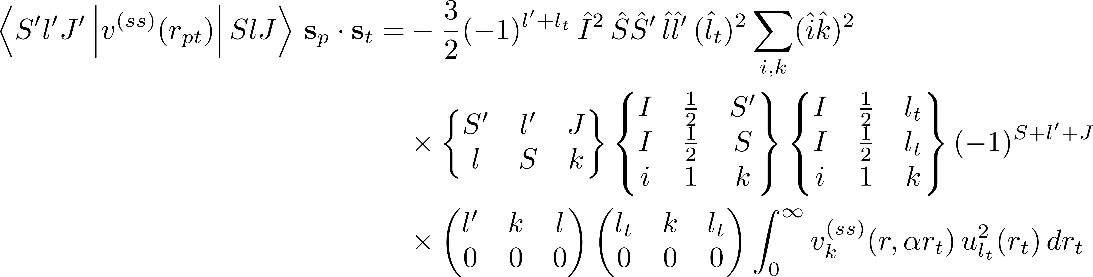

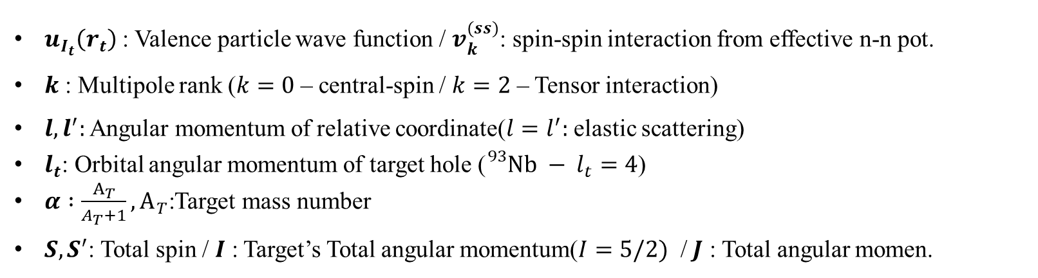
Valence-model potential for central spin-spin N-N interaction
The valence model potential for $s_{p} ∙s_{t}$ and between states $(S,l,J)$ and $(S′,l^{′},J)$
$$=U_{Sl,S^{′}l^{′}}^{\left(ss\right)}(r)$$
$u_{I_{t}}\left(r_{t}\right)$ : Valence particle wave function / $v_{k}^{(ss)}$: spin-spin interaction from effective n-n pot.
$k$ : Multipole rank ($k=0$ – central-spin / $k=2$ – Tensor interaction)
$l,l^{′}:$ Angular momentum of relative coordinate($l=l^{′}:$ elastic scattering)
$l_{t}$: Orbital angular momentum of target hole (${}_{}^{93}{Nb} − l_{t}=4$)
$α :\frac{A_{T}}{A_{T}+1}, A_{T}$:Target mass number
$S,S^{′}$: Total spin / $I$ : Target’s Total angular momentum($I=5/2)$ / $J$ : Total angular momen.

Slide 8
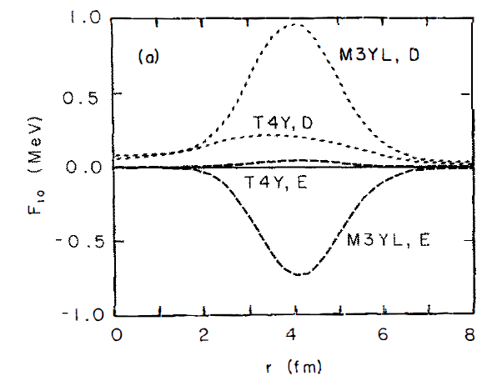
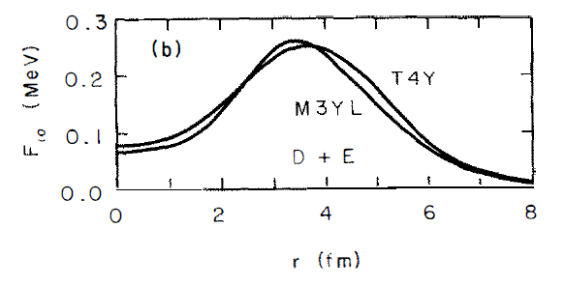
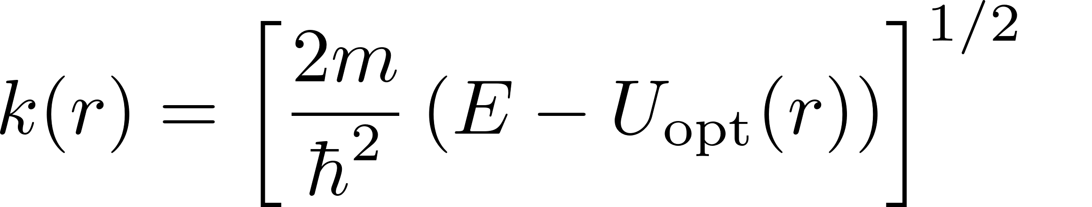
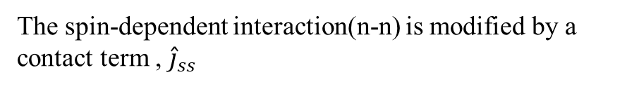
Exchange approximation
Exchange part from the spin-spin interactions
The spin-dependent interaction(n-n) is modified by a contact term , ${\hat{j}}_{ss}$
with the exchange term
Local-energy approximation in which the projectile wave number is computed from the local energy
The local Fermi momentum of target nucleons is
T.L McABEE (NPA A509(1990)39-79)

Slide 9
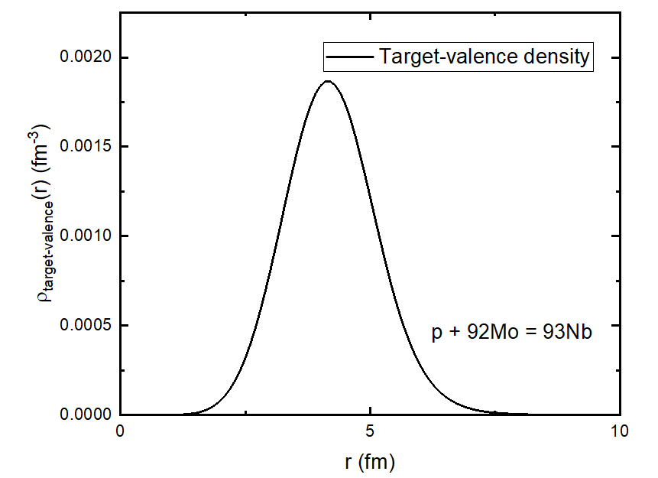
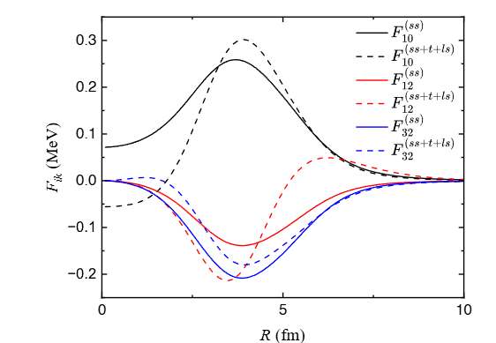
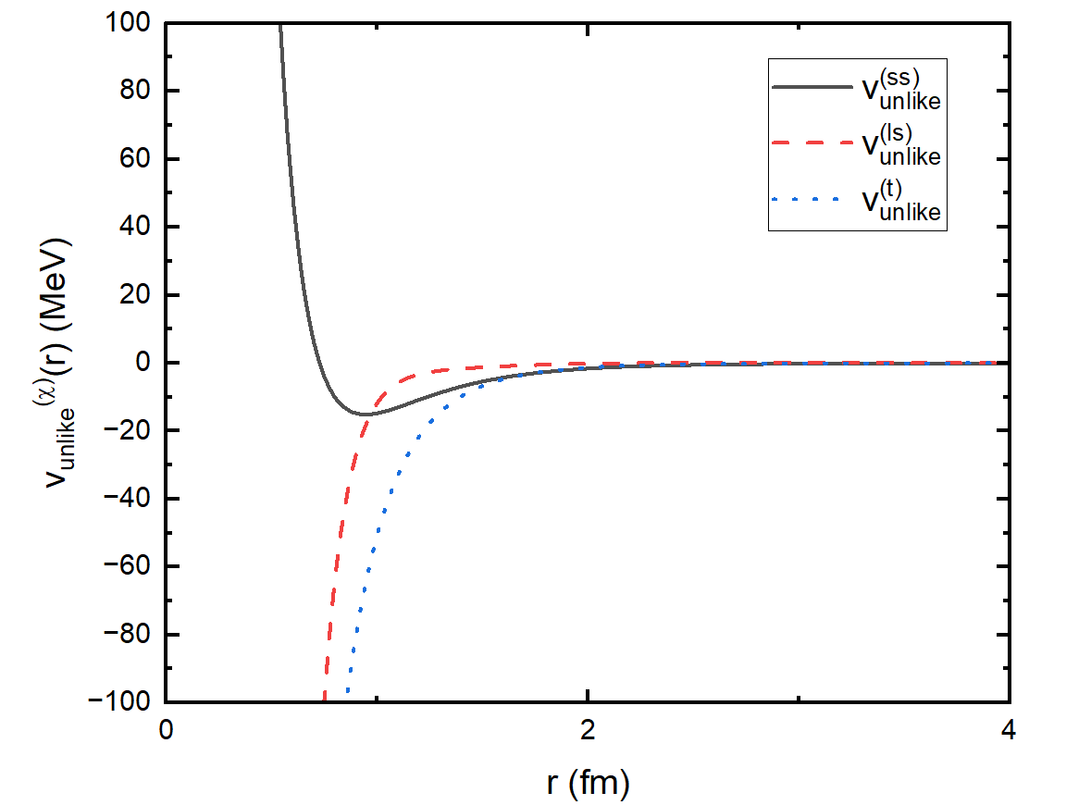
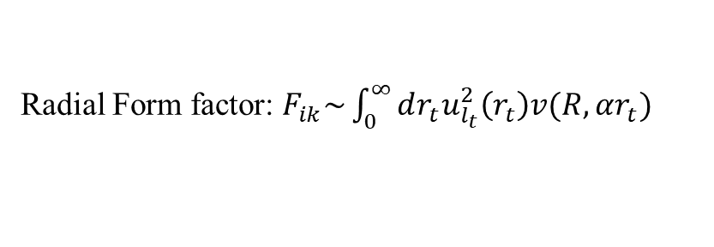
Exchange approximation
Radial formfactor
Valence nucleon density
Radial Form factor: $F_{ik}\sim \int_{0}^{∞}{dr_{t}u_{l_{t}}^{2}\left(r_{t}\right)v(R,αr_{t})}$
N-N interaction (T4Y)

Slide 10






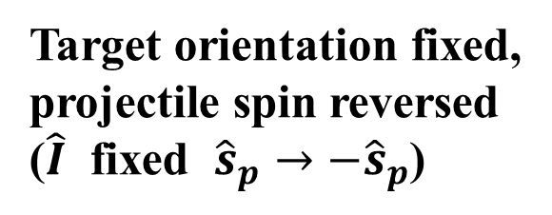

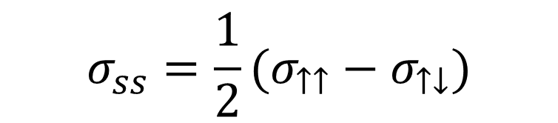


Parallel and antiparallel spin configuration
Target orientation fixed,
projectile spin reversed
($\hat{I}$ fixed ${\hat{s}}_{p}→−{\hat{s}}_{p}$)
$$S_{ik}(I,−s_{p},\hat{R})=−S_{ik}(I,s_{p},\hat{R})$$
$$\hat{I}$$
$$\hat{k}$$
$$σ_{↑↑}=σ_{cen}+σ_{ss}$$
$${\hat{s}}_{p}$$
<parallel>
$$\hat{I}$$
$$\hat{k}$$
$$σ_{↑↓}=σ_{cen}−σ_{ss}$$
<antiparallel>
$${\hat{s}}_{p}$$
$$σ_{ss}=\frac{1}{2}(σ_{↑↑}−σ_{↑↓})$$

Slide 11


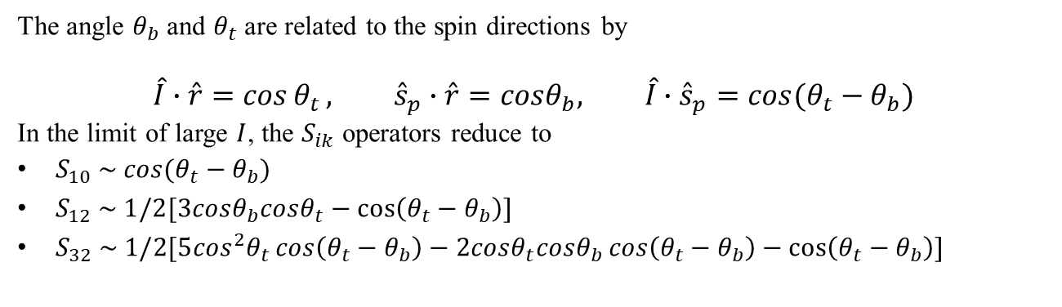

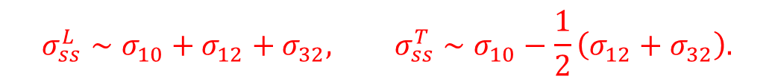





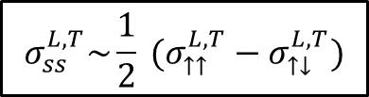

N
$$σ_{ss}^{L,T}\sim \frac{1}{2} (σ_{↑↑}^{L,T}−σ_{↑↓}^{L,T})$$
Spin geometry and angular dependence of $S_{ik}$
$$\hat{I}$$
$$\hat{k}$$
<Longitudinal>
$${\hat{s}}_{p}$$
$${\hat{n}}_{spin}∥ \hat{k}$$
N
$$\hat{k}$$
$$\hat{I}$$
<Transverse>
$${\hat{n}}_{spin}⊥ \hat{k}$$
$${\hat{s}}_{p}$$
The angle $θ_{b}$ and $θ_{t}$ are related to the spin directions by
$$\hat{I}∙\hat{r}=\cos{θ_{t}}, {\hat{s}}_{p}∙\hat{r}=cosθ_{b}, \hat{I}∙{\hat{s}}_{p}=cos⁡(θ_{t}−θ_{b})$$
In the limit of large $I$, the $S_{ik}$ operators reduce to
$S_{10} \sim cos⁡(θ_{t}−θ_{b})$
$S_{12} \sim 1/2[3cosθ_{b}cosθ_{t}−cos⁡\left(θ_{t}−θ_{b}\right)]$
$S_{32} \sim 1/2[5\cos^{2}θ_{t}\cos\left(θ_{t}−θ_{b}\right)−2cosθ_{t}cosθ_{b}\cos\left(θ_{t}−θ_{b}\right)−\cos\left(θ_{t}−θ_{b}\right)]$
S
S
$$σ_{ss}^{L}∼σ_{10}+σ_{12}+σ_{32}, σ_{ss}^{T}∼σ_{10}−\frac{1}{2}\left(σ_{12}+σ_{32}\right).$$

Slide 12
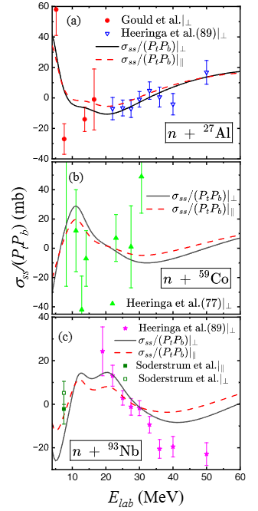

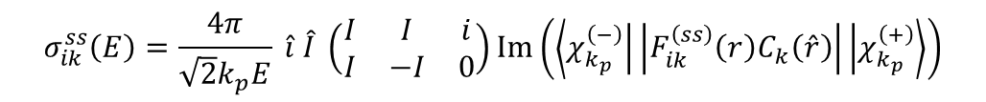
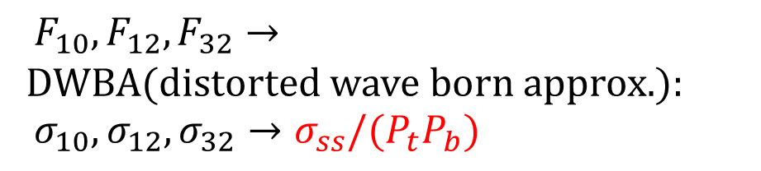
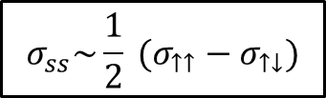
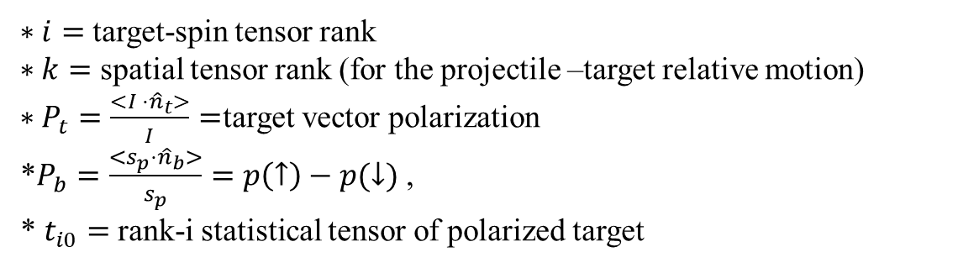

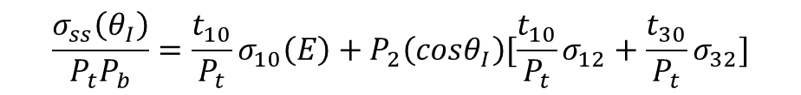

$$σ_{ss}\sim \frac{1}{2} (σ_{↑↑}−σ_{↑↓})$$
Neutron benchmark
What is the benchmark?
$F_{10},F_{12},F_{32}→$
DWBA(distorted wave born approx.):
$σ_{10},σ_{12},σ_{32}→σ_{ss}/(P_{t}P_{b})$
$$\left({\frac{5}{2}}^{+}\right)$$
$$σ_{ik}^{ss}\left(E\right)=\frac{4π}{\sqrt{2}k_{p}E} \hat{i} \hat{I} \left(\begin{matrix}I & I & i \\ I & −I & 0\end{matrix}\right)Im\left(\left\langle χ_{k_{p}}^{\left(−\right)} | \left|F_{ik}^{\left(ss\right)}\left(r\right)C_{k}\left(\hat{r}\right)\right| | χ_{k_{p}}^{\left(+\right)}\right\rangle \right)$$
$$\frac{σ_{ss}\left(θ_{I}\right)}{P_{t}P_{b}}=\frac{t_{10}}{P_{t}}σ_{10}\left(E\right)+P_{2}\left(cosθ_{I}\right)[\frac{t_{10}}{P_{t}}σ_{12}+\frac{t_{30}}{P_{t}}σ_{32}]$$
$$\left({\frac{7}{2}}^{−}\right)$$
$∗i=$target-spin tensor rank
$∗k=$ spatial tensor rank (for the projectile –target relative motion)
$∗P_{t}=\frac{<I ⋅{\hat{n}}_{t}>}{I}=$target vector polarization
*$P_{b}=\frac{<s_{p}⋅{\hat{n}}_{b}>}{s_{p}}=p\left(↑\right)−p(↓)$ ,
* $t_{i0}=$rank-i statistical tensor of polarized target
$$\left({\frac{9}{2}}^{+}\right)$$
Neutron data constrain the sign and scale of the folded spin-spin form factors before they are used in the proton-fusion calculation.

Slide 13
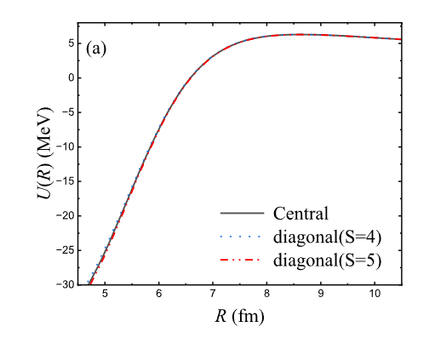
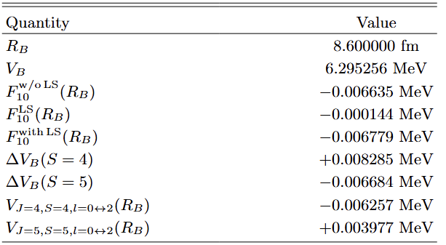
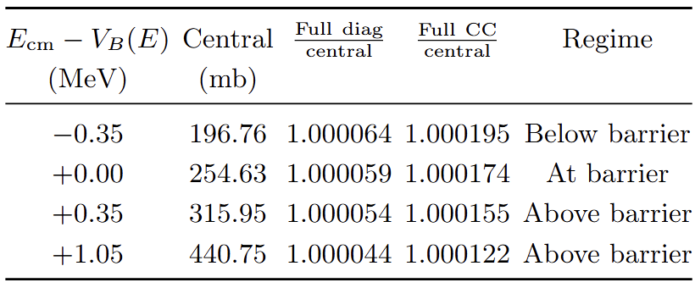

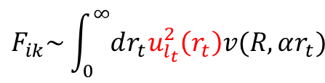

Proton-Nucleus Result
$$F_{ik}\sim \int_{0}^{∞}{dr_{t}u_{l_{t}}^{2}\left(r_{t}\right)v(R,αr_{t})}$$
$$\sim 8.6 fm$$
$$p+{}_{}^{93}{Nb}$$

Slide 14
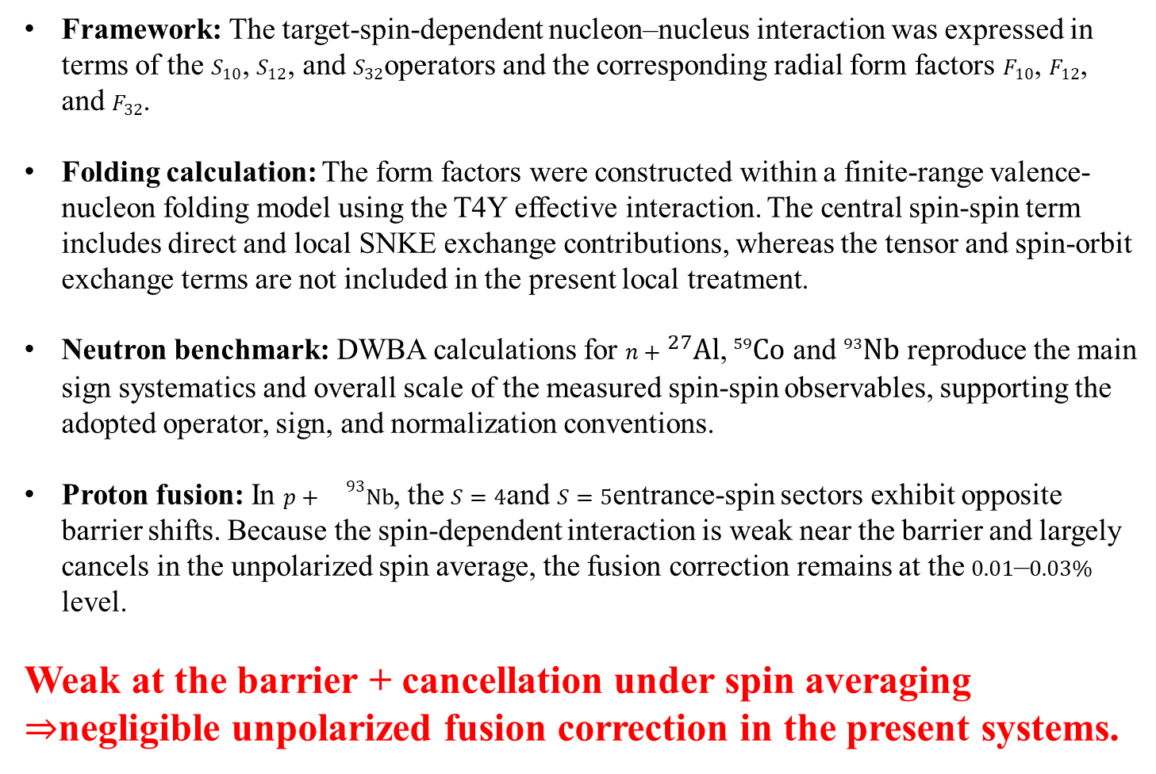
Kyoungsu Heo, et al. arXiv:2605.26561 [nucl-th]
Exchange approximation
Summary
Framework: The target-spin-dependent nucleon–nucleus interaction was expressed in terms of the $S_{10}$, $S_{12}$, and $S_{32}$operators and the corresponding radial form factors $F_{10}$, $F_{12}$, and $F_{32}$.
Folding calculation: The form factors were constructed within a finite-range valence-nucleon folding model using the T4Y effective interaction. The central spin-spin term includes direct and local SNKE exchange contributions, whereas the tensor and spin-orbit exchange terms are not included in the present local treatment.
Neutron benchmark: DWBA calculations for $n+{}_{}^{27}{Al}$, ${}_{}^{59}{Co}$ and ${}_{}^{93}{Nb}$ reproduce the main sign systematics and overall scale of the measured spin-spin observables, supporting the adopted operator, sign, and normalization conventions.
Proton fusion: In $p+{}^{93}Nb$, the $S=4$and $S=5$entrance-spin sectors exhibit opposite barrier shifts. Because the spin-dependent interaction is weak near the barrier and largely cancels in the unpolarized spin average, the fusion correction remains at the $0.01$–$0.03\%$ level.
Weak at the barrier + cancellation under spin averaging
$⇒$negligible unpolarized fusion correction in the present systems.

Slide 15

감사합니다.

Slide 16
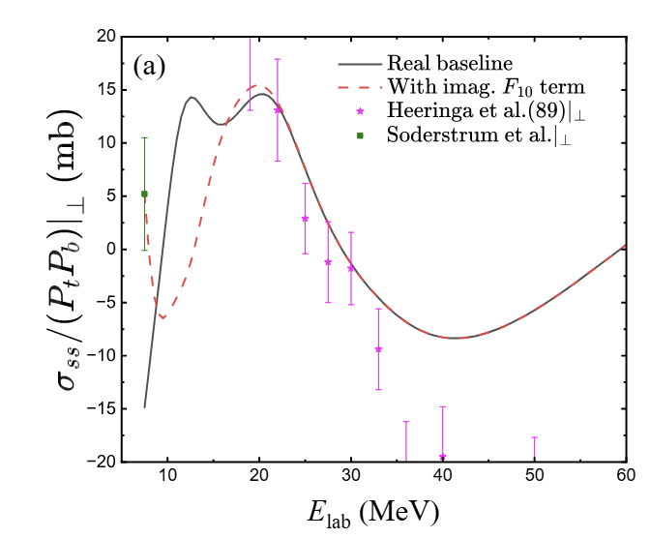

Slide 17
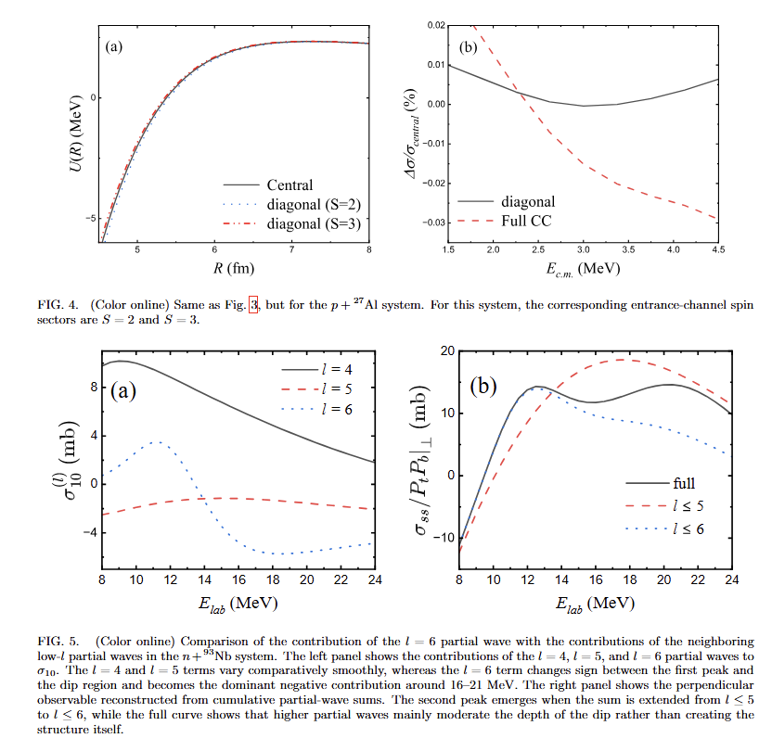

Slide 18
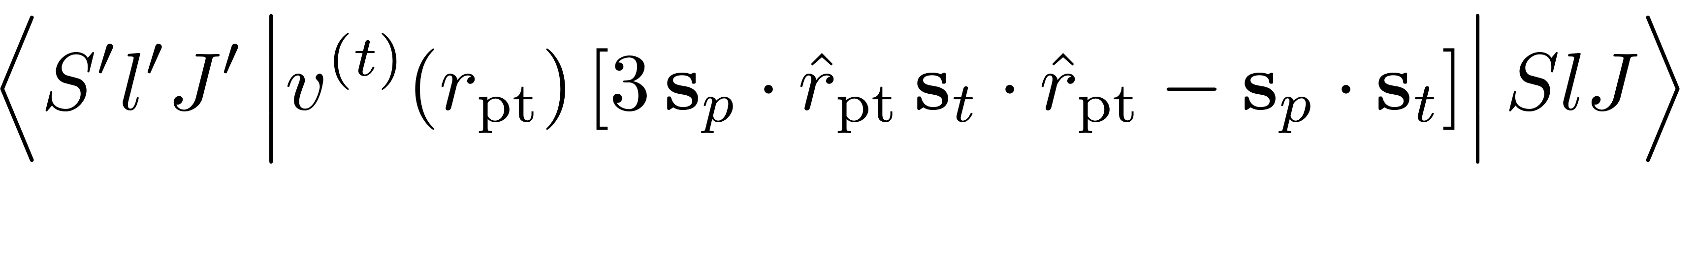
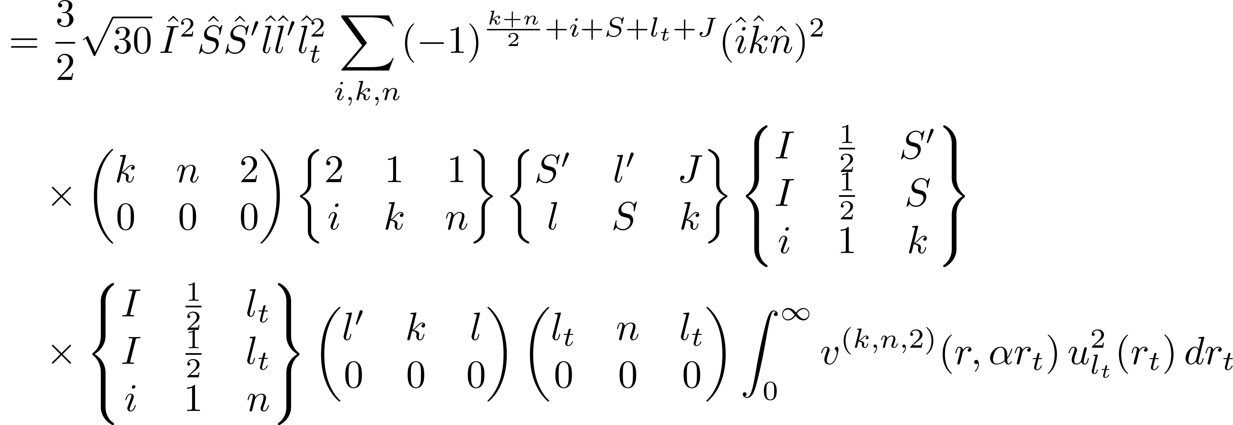
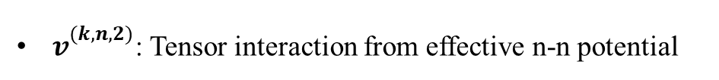

Exchange approximation
Valence-model potential for tensor interactions
Recoupling spin-angle coordinates by Horie and Sasaki[Ref.] and performing angular integrations, we obtain the nucleon-nucleus tensor interaction multipole moments between states $(S,l,J)$ and $(S′,l^{′},J)$
$v_{}^{(k,n,2)}$: Tensor interaction from effective n-n potential

