Slide 1
Effective Field Theories for nuclear reactions at low energies
Shung-Ichi Ando
Sunmoon University
NuSRAP2026@CCS, Tsukuba U., Japan, July 13-15, 2026

Slide 2
Outline
Introduction
Effective field theories for nuclear reactions at low energies
Elastic n-16O scattering at low energies [arXiv:2607.04836]
Summary and discussion

Slide 3
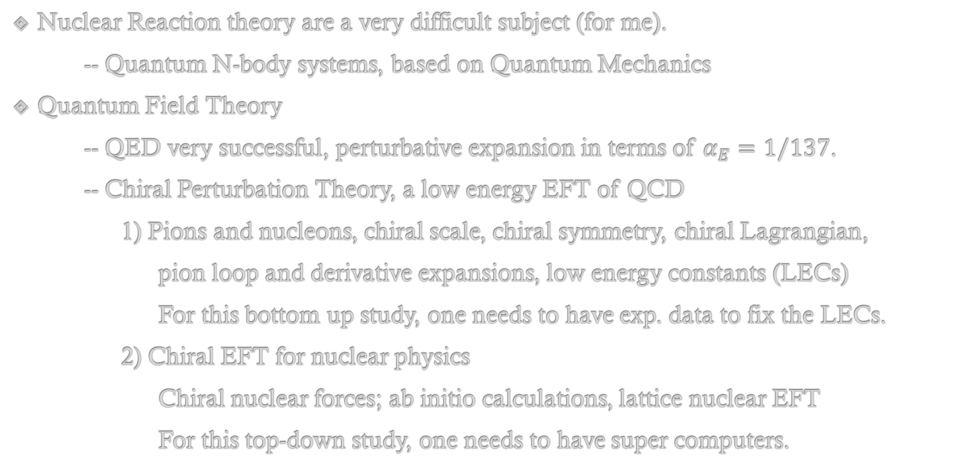
Introduction
Nuclear Reaction theory are a very difficult subject (for me).
-- Quantum N-body systems, based on Quantum Mechanics
Quantum Field Theory
-- QED very successful, perturbative expansion in terms of $α_{E}=1/137$.
-- Chiral Perturbation Theory, a low energy EFT of QCD
1) Pions and nucleons, chiral scale, chiral symmetry, chiral Lagrangian,
pion loop and derivative expansions, low energy constants (LECs)
For this bottom up study, one needs to have exp. data to fix the LECs.
2) Chiral EFT for nuclear physics
Chiral nuclear forces; ab initio calculations, lattice nuclear EFT
For this top-down study, one needs to have super computers.

Slide 4
EFTs for nuclear reactions at low energies
Building an EFT for nuclear reactions
-- Setting a scale, choosing relevant degrees of freedom at low energies,
-- Constructing an effective Lagrangian, and calculating an reaction amplitude,
-- Low-energy constants
For the bottom-up study, one needs to have the experimental data.
Target subjects for this approach
-- Low energy reactions where resonances can be separable and exp. data available
1) Estimates of the S factors for nuclear astrophysics
2) Nuclear data evaluations for nuclear engineering

Slide 5
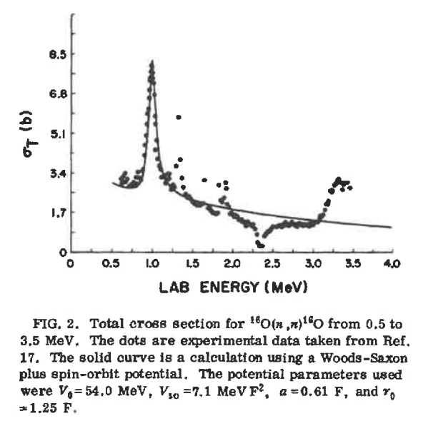
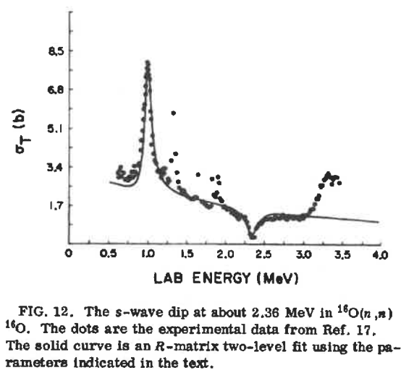
Elastic n-16O scattering at low energies
Early studies in the 1950s
One of the highest priority isotopes, 1H, 16O, 56Fe, 235,238U, and 239Pu for the CIELO collaboration, the evaluated data in ENDF/B-VIII.0.
From Christian Ilidias’ textbook, Nuclear Physics of Stars;
It is difficult to describe a potential model in Fig. 2.19 (from Westin and Adams 1972).

Slide 6
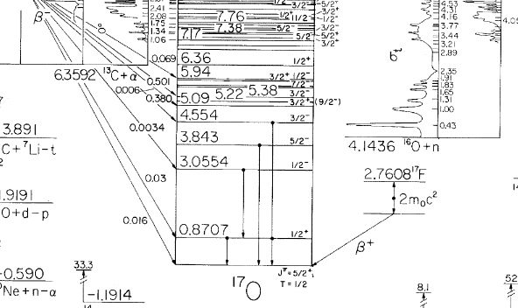
Level diagram of 17O
TUNL nuclear evaluation data

Slide 7
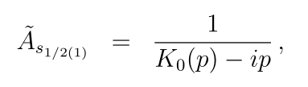
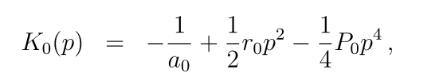
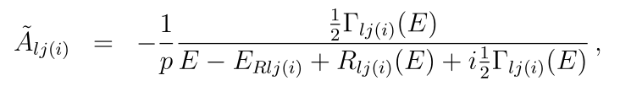
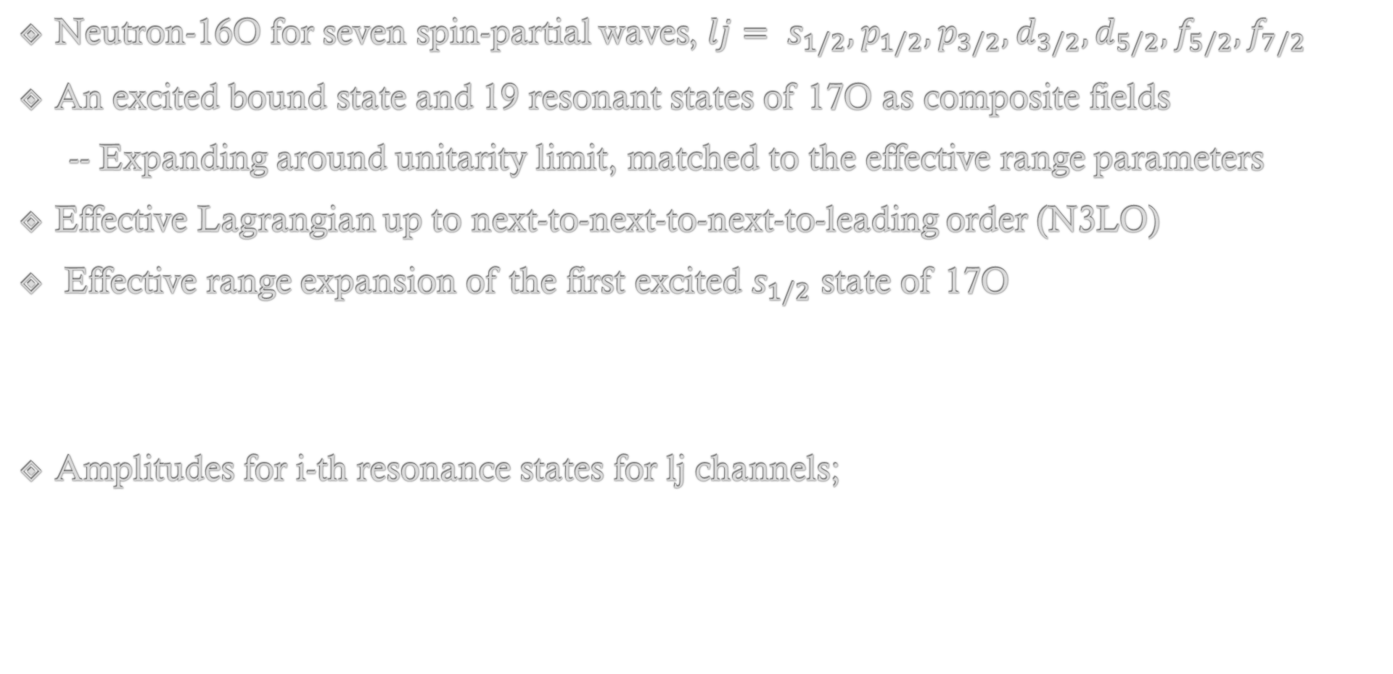
An EFT of 16O(n,n)16O at $0≤E_{n}≤4$ MeV
Neutron-16O for seven spin-partial waves, $lj= s_{1/2}, p_{1/2}, p_{3/2}, d_{3/2}, d_{5/2}, f_{5/2}, f_{7/2}$
An excited bound state and 19 resonant states of 17O as composite fields
-- Expanding around unitarity limit, matched to the effective range parameters
Effective Lagrangian up to next-to-next-to-next-to-leading order (N3LO)
Effective range expansion of the first excited $s_{1/2}$ state of 17O
Amplitudes for i-th resonance states for lj channels;

Slide 8
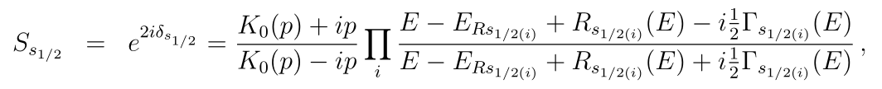

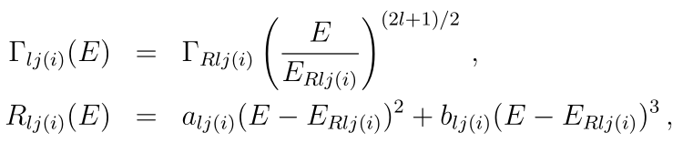

S matrices of 16O(n,n)16O for lj channels
For the $s_{1/2}$ channel (three states, 1, 4 free, and 2 fixed parameters)
For the other channels (16 states and 3 backgrounds, 4 states with large widths include the shape parameters, a and b. 3 states with large errors are excluded from the fit.)

Slide 9
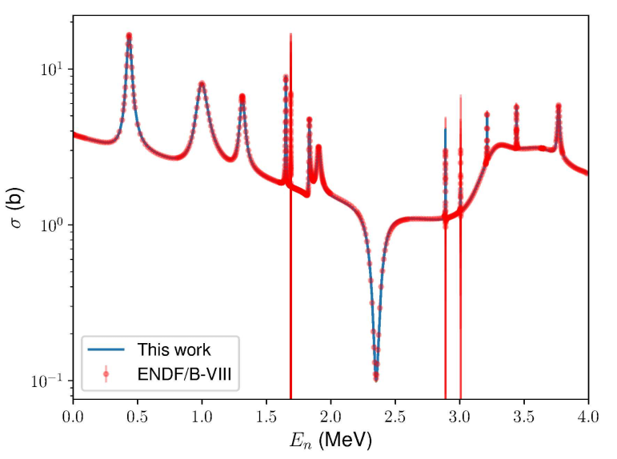
A data set of 16O(n,n)16O from ENDF/B-VIII.0
-- within the R-matrix analysis

Slide 10
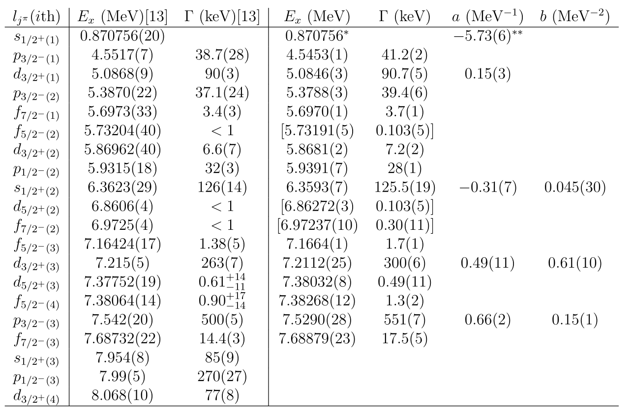
Numerical result (fitted parameters)
[13] Tilley, Weller, Cheves, NPA564,1(1993)

Slide 11
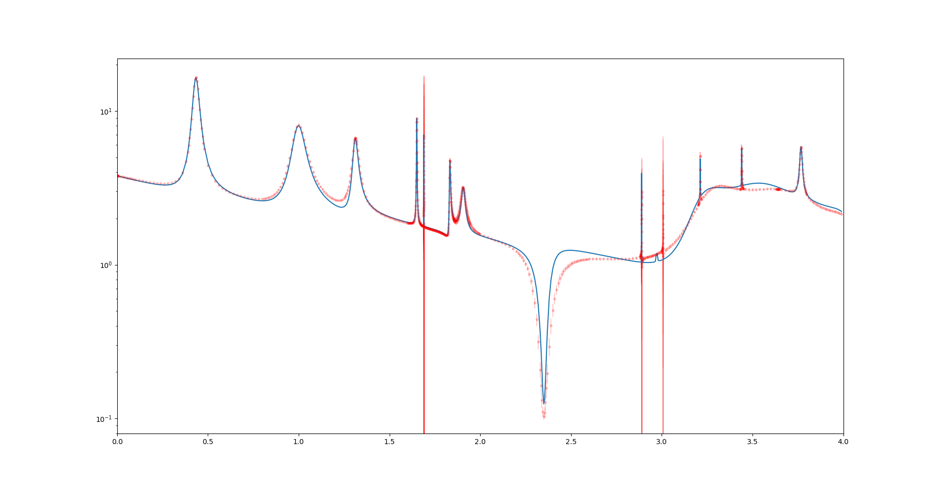
First fit up to NLO: ${χ^{2}}/N=9.44, N=742$

Slide 12
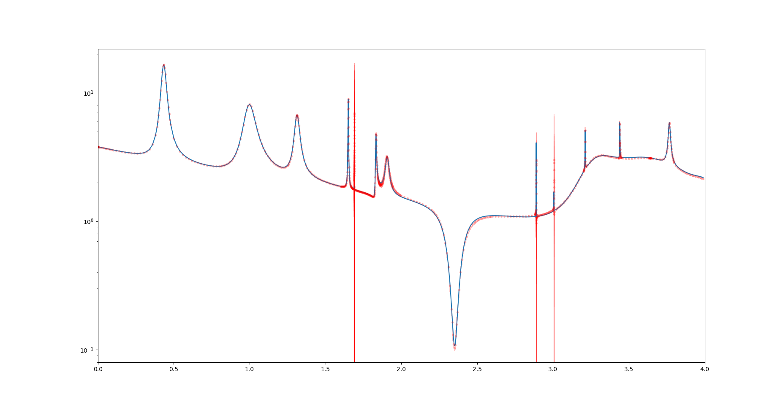
Second fit up to N3LO: ${χ^{2}}/N=0.268, N=742$

Slide 13
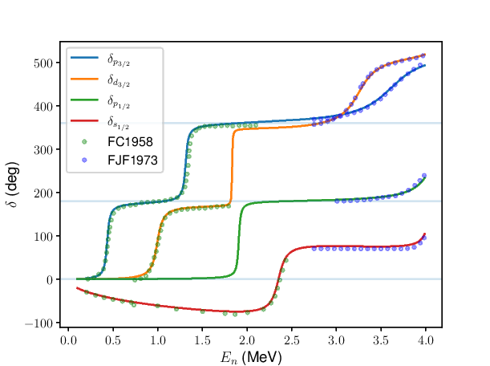
Phase shifts of elastic scattering for $lj= s_{1/2}, p_{1/2}, p_{3/2}, d_{3/2}$
Fowler and Cohn PR109,89(1958),
Fowler, Johnson, Feezel PRC8, 545 (1973)

Slide 14
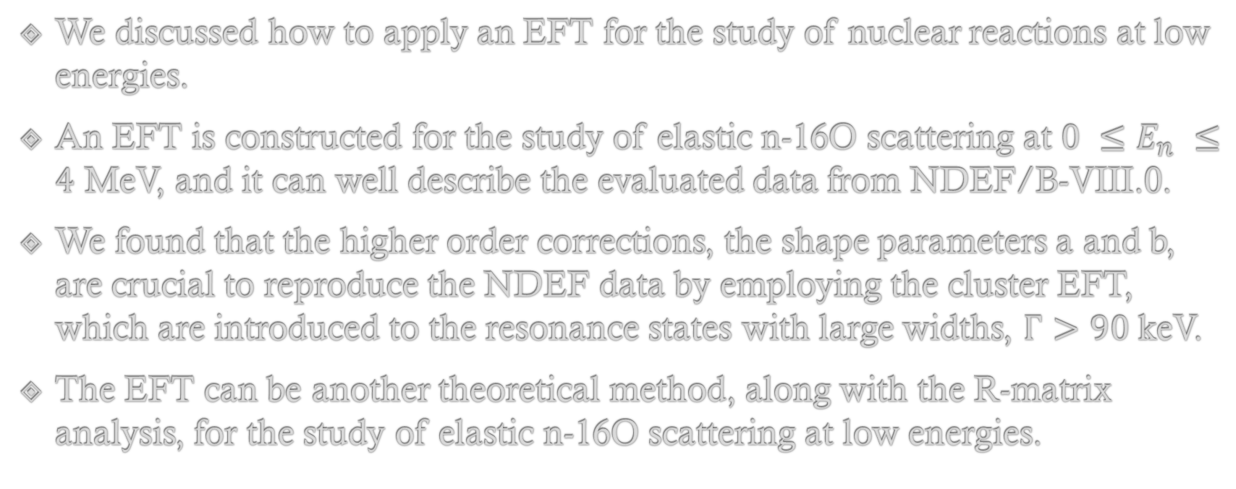
Summary and discussion
We discussed how to apply an EFT for the study of nuclear reactions at low energies.
An EFT is constructed for the study of elastic n-16O scattering at $0 ≤E_{n} ≤4$ MeV, and it can well describe the evaluated data from NDEF/B-VIII.0.
We found that the higher order corrections, the shape parameters a and b, are crucial to reproduce the NDEF data by employing the cluster EFT, which are introduced to the resonance states with large widths, $Γ>90$ keV.
The EFT can be another theoretical method, along with the R-matrix analysis, for the study of elastic n-16O scattering at low energies.

