Slide 1
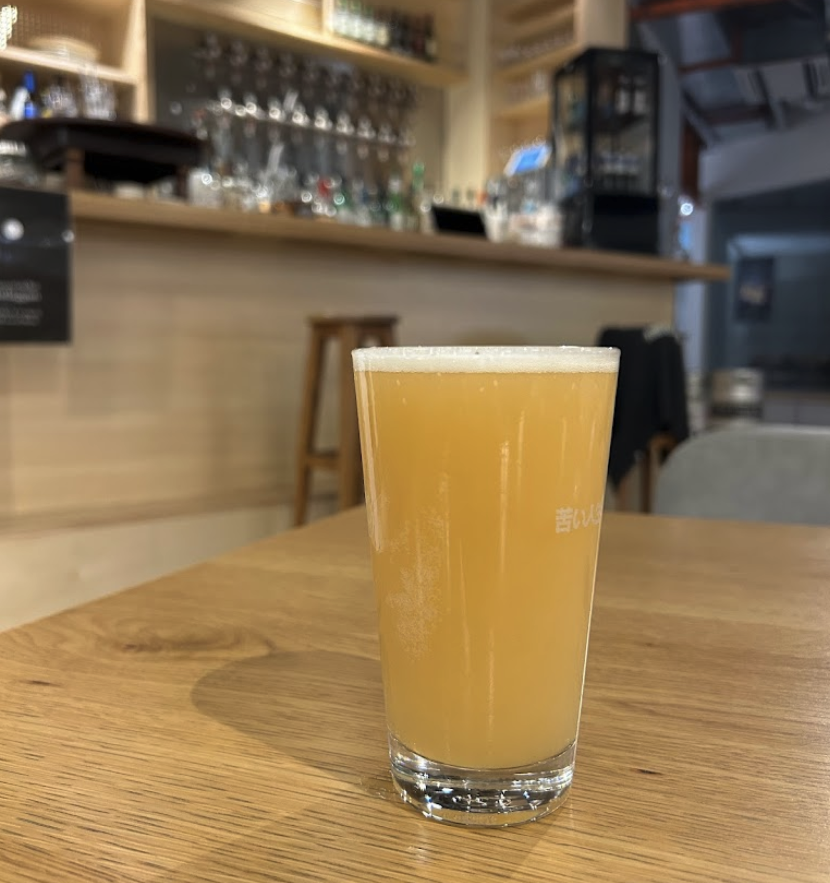
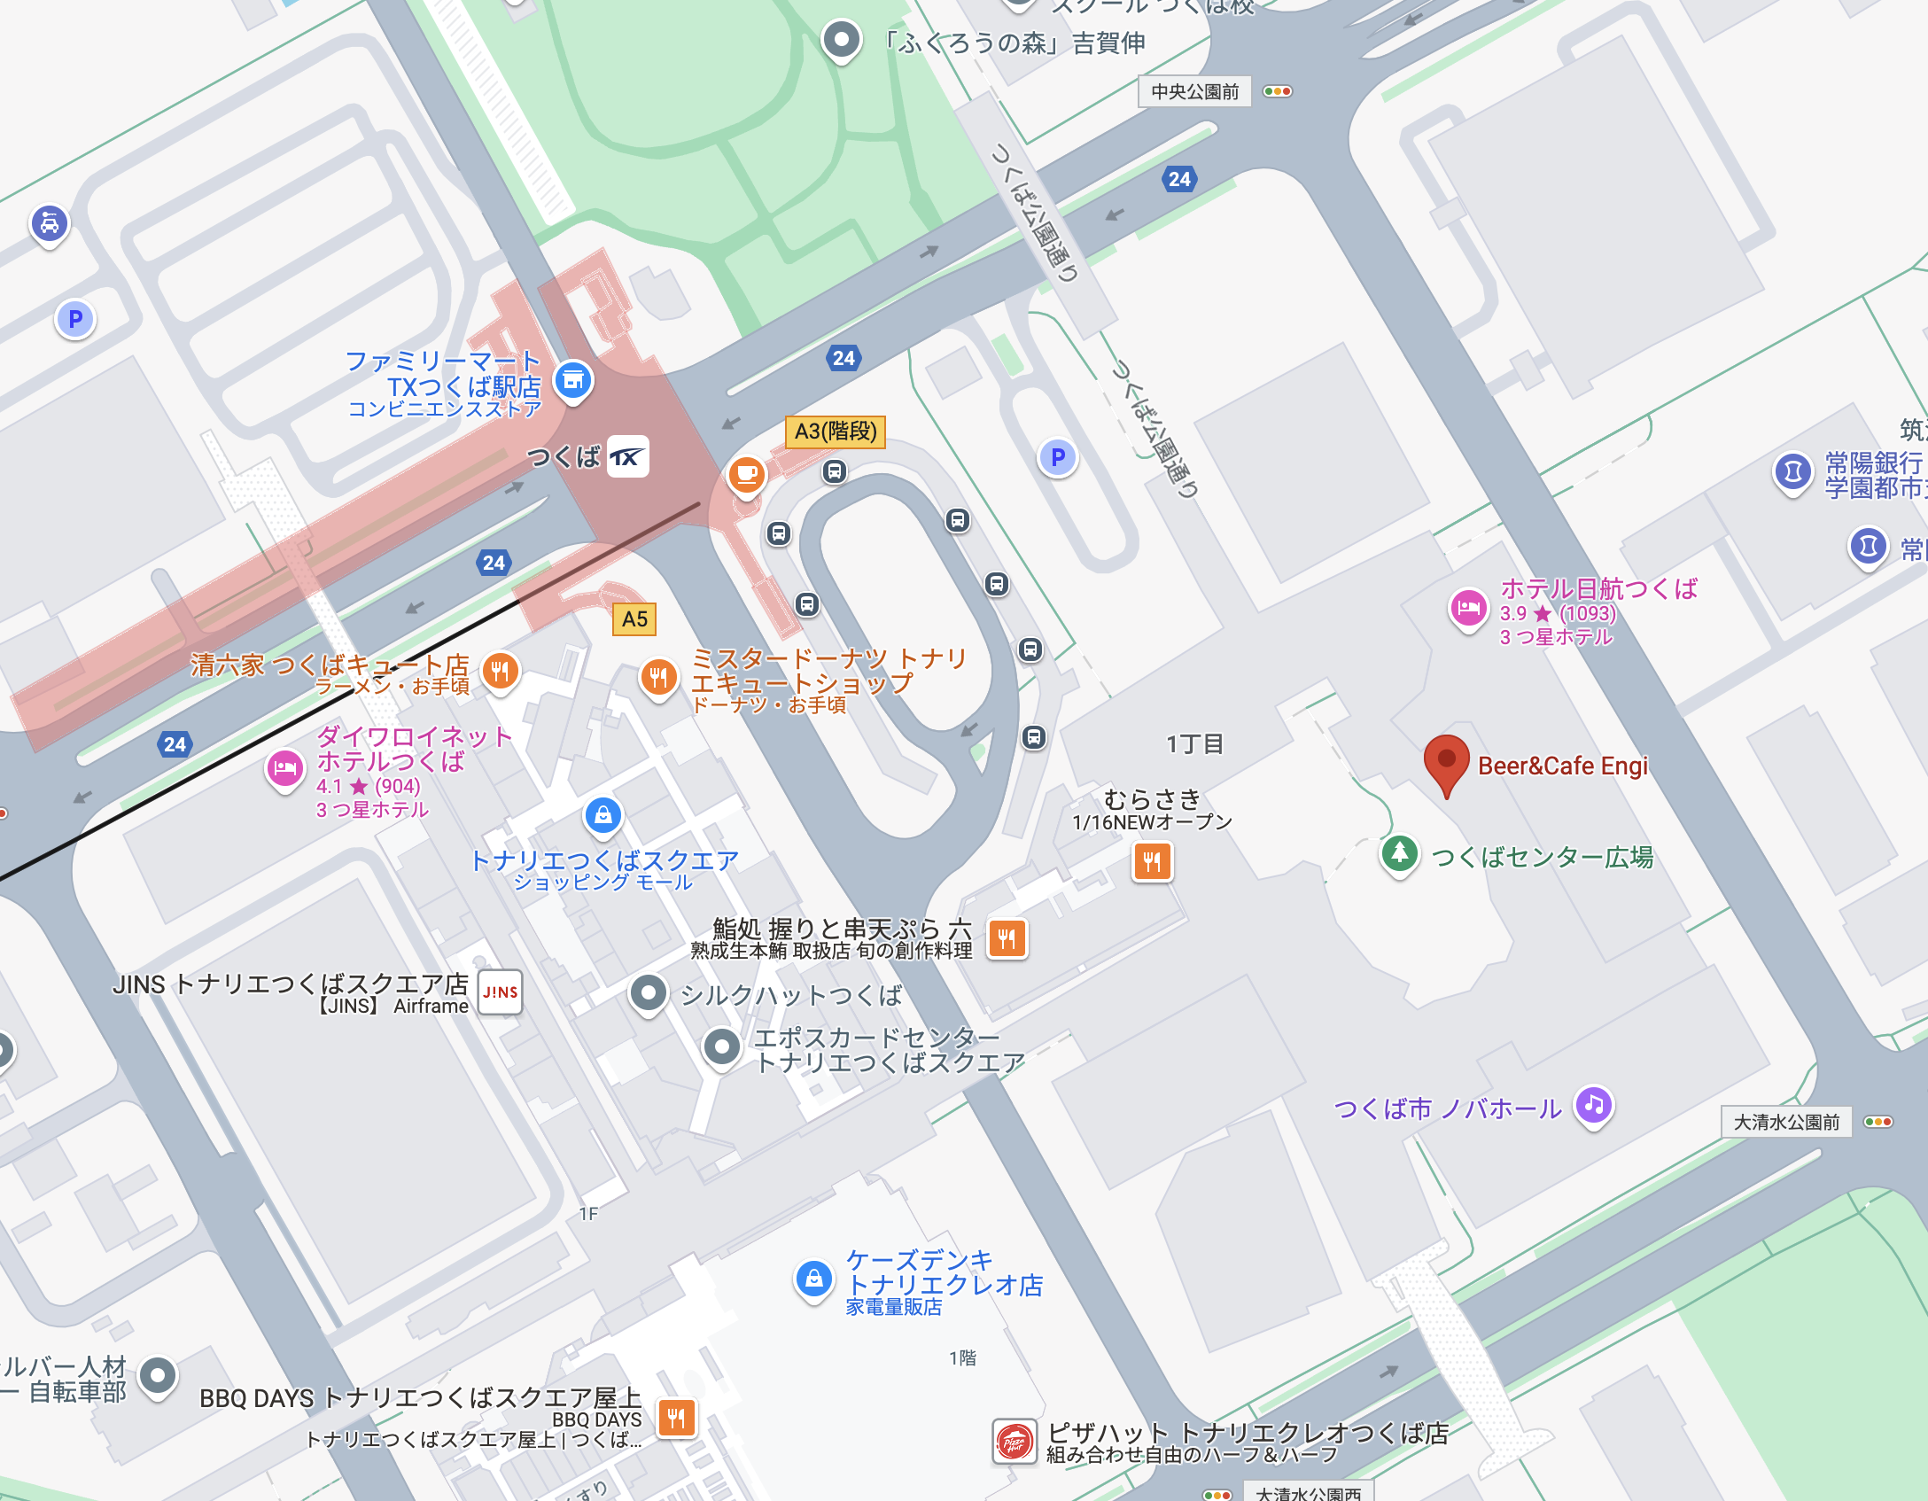
Welcome drink at Café “Engi” (September 22nd (Sun), 2024)
Hotel Nikko Tsukuba
You can access “Engi” from the ground floor of Hotel Nikko Tsukuba.

