Slide 1
Majorana fermions in condensed matter physics. Examples
Alexei Tsvelik
CMPMS Division
Eugene Feenberg award presentation

Slide 2




My main collaborators
Alexander Nersesyan
Paul Wiegmann
Piers Coleman
Fabian Essler

Slide 3
Plan of the talk
Majorana fermions appear in different areas of condensed matter physics.
They are as quasiparticles and as collective excitations.
I will discuss two examples related to my own research; both ones are related collective excitations.

Slide 4
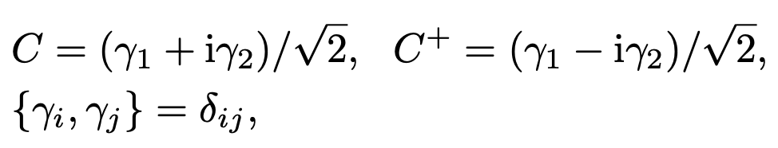
What is Majorana fermion?
Majorana (real) fermions appear in condensed matter physics in different contexts.
They can emerge as quasiparticles, for example in superconductors with strong SOC.
They can emerge as collective excitations (in spin liquids).
They can appear in ground states of magnetic impurities (2 channel Kondo effect).
Ettore Majorana

Slide 5
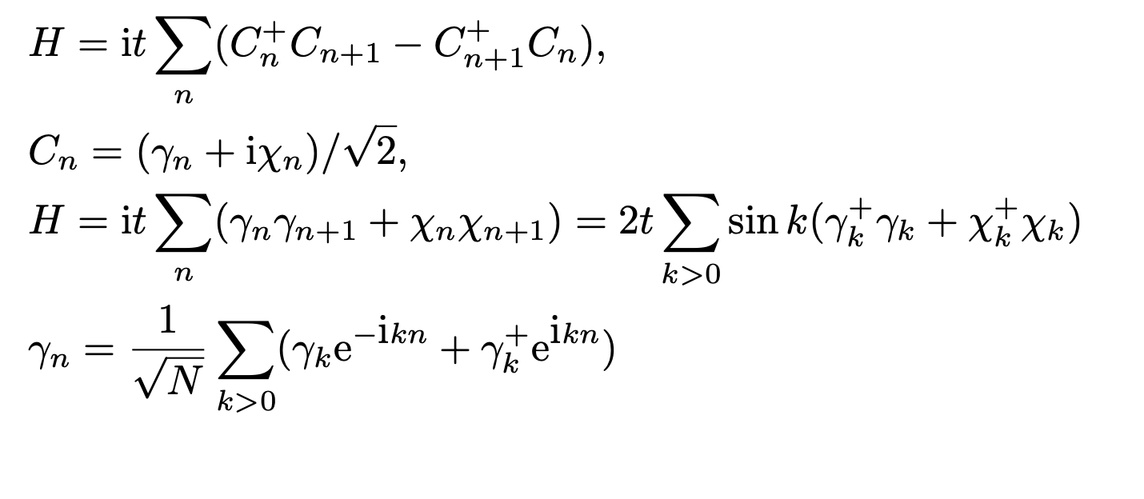
Can Majoranas propagate?
Take real and imaginary part of Dirac fermion and you get two Majoranas.
Majorana fermion occupies
half of the Brillouin zone

Slide 6
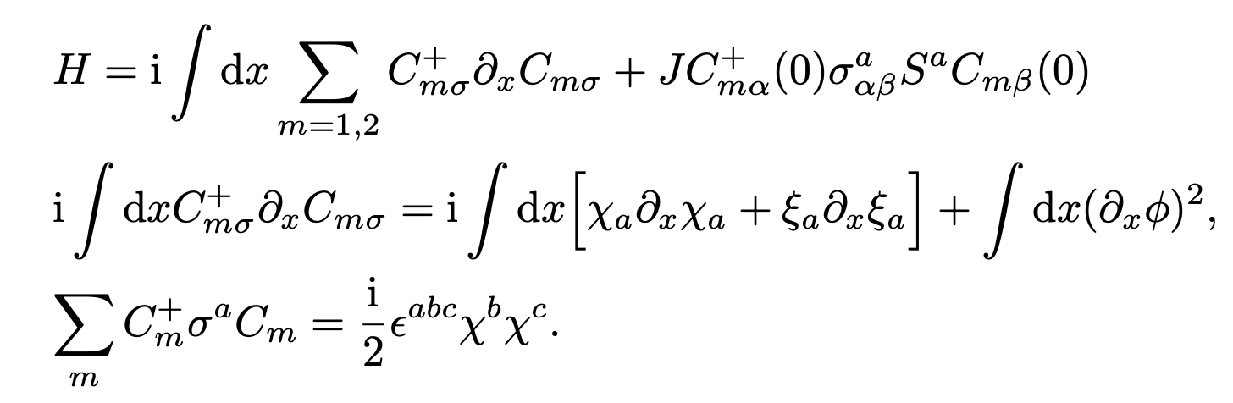
Example #1. Majorana fermions in 2-channel Kondo effect
Spin S=1/2
Electrons
Non-Abelian
bosonization
Identical commutation
relations

Slide 7
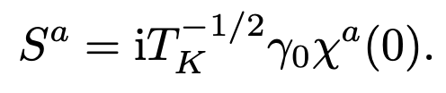
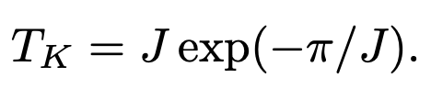
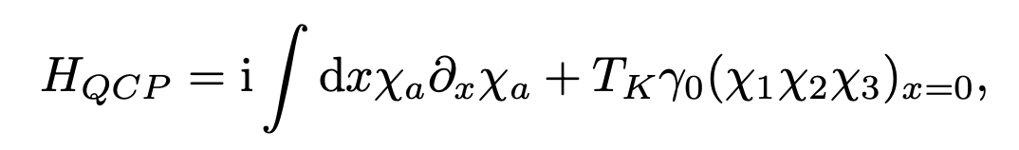
Fractionalization of the impurity spin in Kondo models
2-channel Kondo effect is quantum critical. Its ground state has finite
entropy
(Tsvelick, Wiegmann 1984). It has a Majorana zero mode γ₀ in the ground
state. Operator transmutation:
The effective Hamiltonian below Kondo temperature
γ₀
is a Majorana fermion located at the impurity site. That is all what remains from the spin after screening!

Slide 8
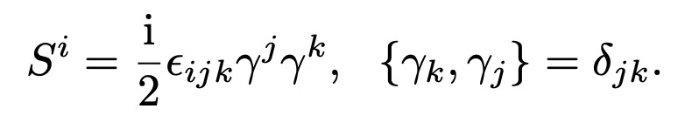
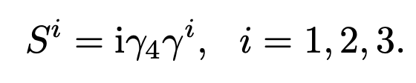
Example #2: Majoranas in spin liquids
The idea comes from the fact that spin-1/2 operators can be expressed as Majorana bilinears
γ₁ γ₂γ₃ γ₄ = 1/4 −all commutation relations are satisfied.
Alternative representation:
Using this trick one can fermionize the Kitaev spin Hamiltonian transforming it into Z₂ gauge theory.
The idea that spin liquids
can bear a triplet of propagating
Majoranas: Tsvelik (1992), Shelton,
Tsvelik, Nersesyan (1996)

Slide 9
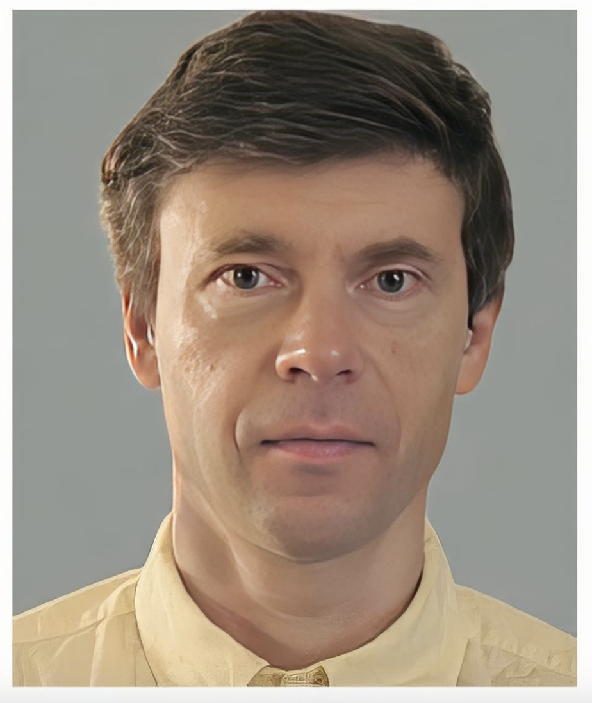
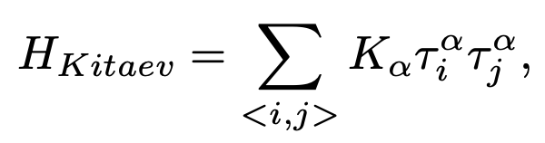
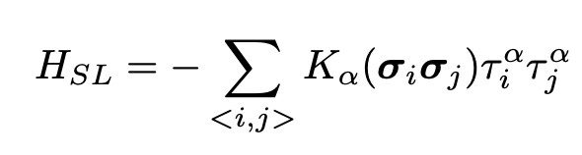
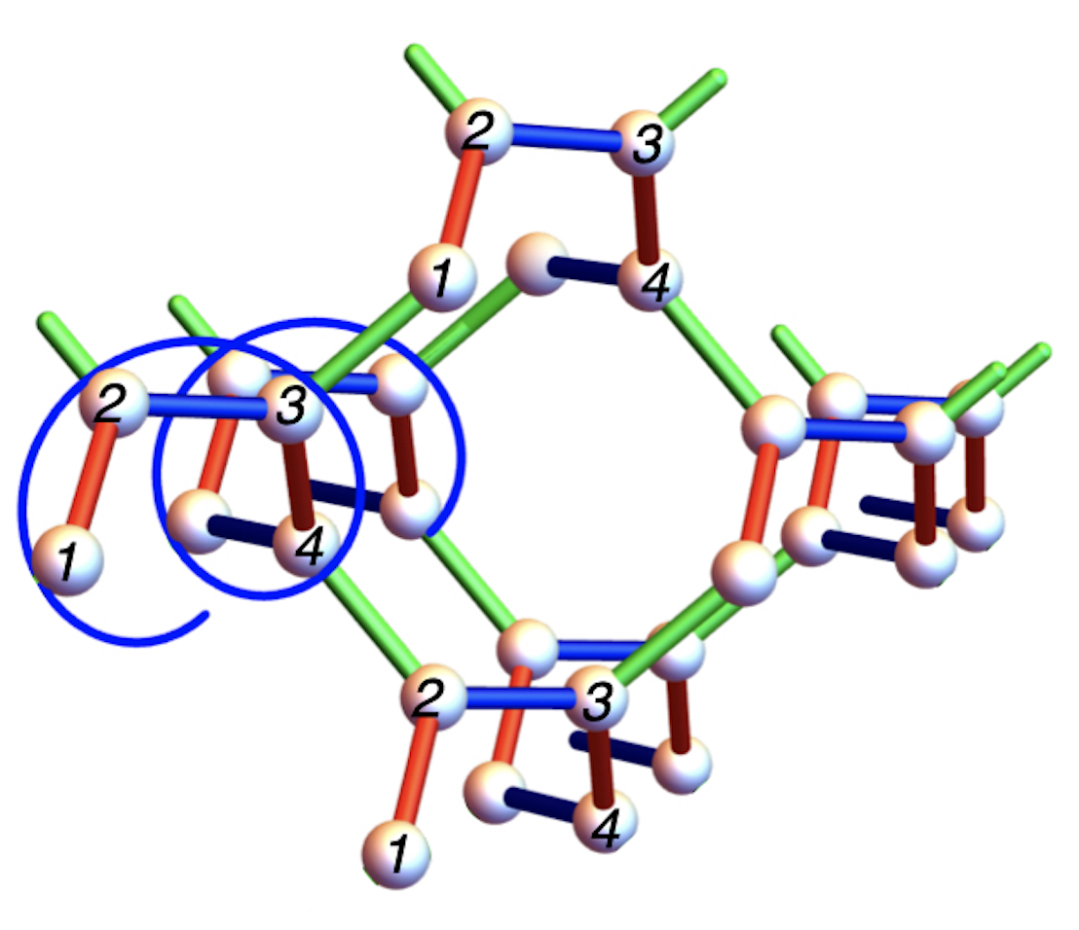
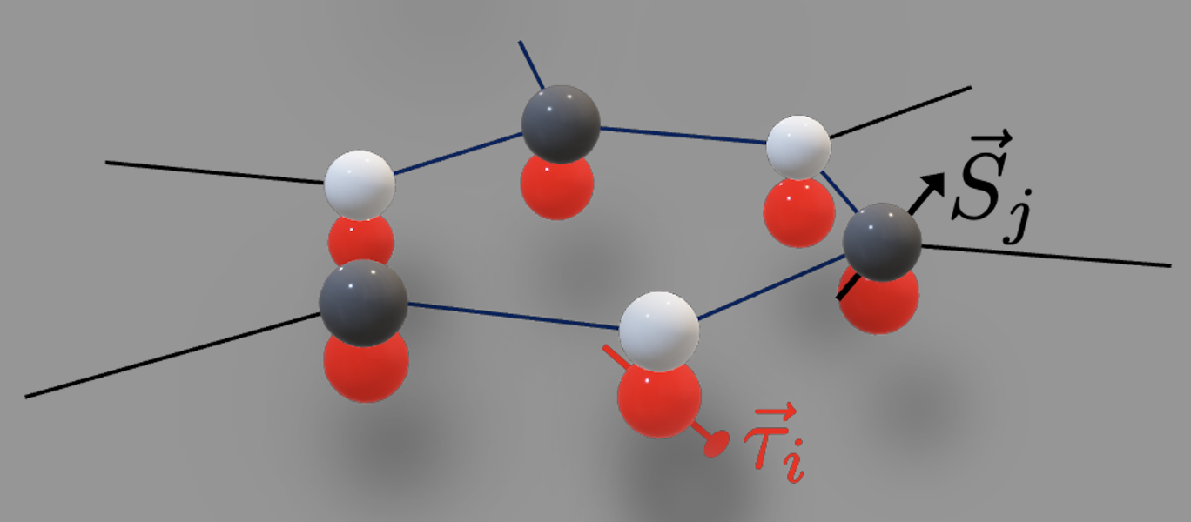
Solvable spin liquids: Kitaev and Yao-Lee models
Yao=Lee: in addition to spins σ there are orbital degrees of freedom described by the Pauli matrices τ so that the interaction is of the Kitaev-like form (H.Yao, D.-H. Lee, PRL 107,087205(2011)).
These models are exactly solvable on any lattice with coordination # 3.
Examples:
2D: hexagonal
lattice
3D: Hyperoctogonal lattice

Slide 10
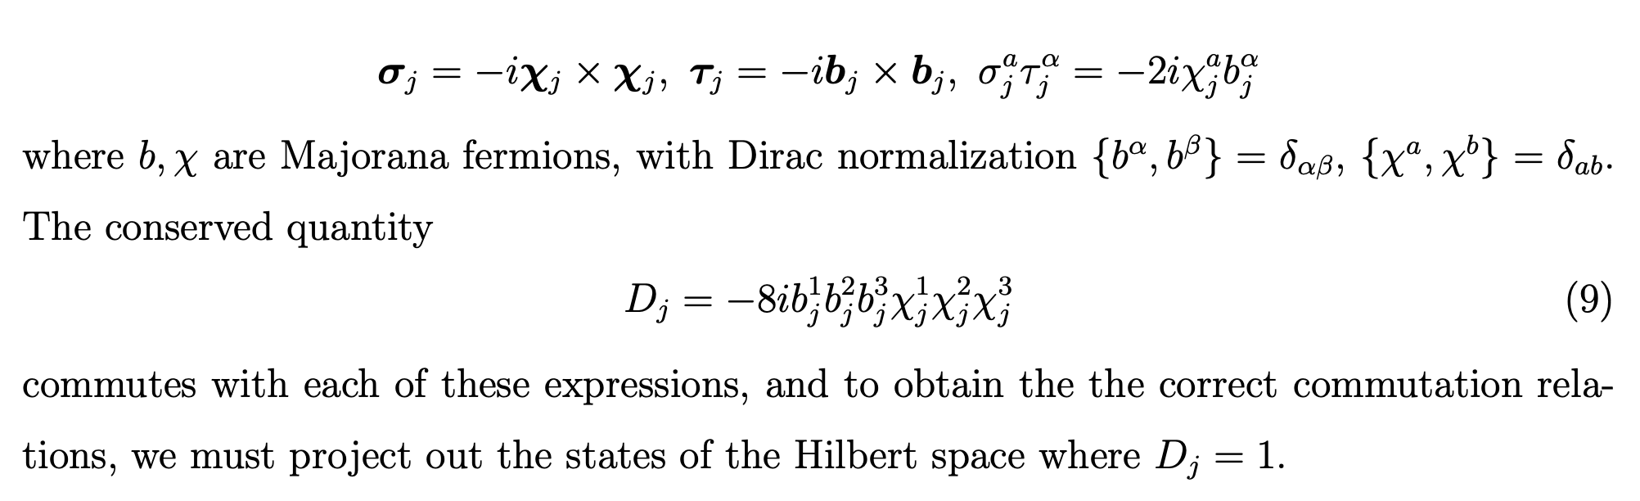
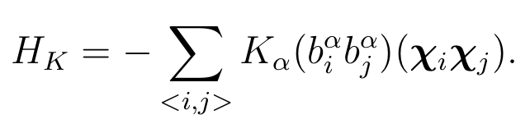
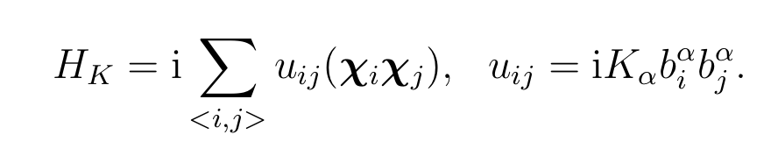

Following Seifert et. al. [PRL 125, 257202 (2020)] we represent the spin-orbital operators
in terms of Majorana fermions:
Then Yao-Lee model becomes
The bilinears of b-fermions on different links commute with each other giving
rise to static Z₂ gauge field:

Slide 13
YL model: excitations
Excitations are
propagating Majorana fermions (3 species),
static Z₂ gauge field fluxes.
At finite T the fluxes are thermally excited, generate finite mean free path for the Majoranas .
In 2D this may be a problem, in 3D it is not - there is a phase transition separating the high-T phase of deconfined fluxes from the low-T phase of confined ones.

Slide 14
The most difficult step is taken: the strong correlations in the SL are taken into account EXACTLY.
The result: the model of spins is transformed into a theory of noninteracting fermions.
Yao-Lee SL: like Kitaev one, but the Majoranas carry S=1 .
Spin ½ is fractionalized as two S=1 Majoranas.
Another important distinction: in Kitaev SL the spin excitations are gapped
(to flip a spin one needs to excite a vison),
but in YL SL the spin excitations are gapless.

Slide 15
Example #3: Majoranas and physics of Kondo lattices
The problem – what happens when itinerant (weakly interacting) electrons actively interact with localized ones (strongly interacting)?
One answer (Doniach): either Fermi liquid where all electrons are absorbed to a single Fermi volume, or magnetic order.
A more exotic situation: the spin subsystem is a liquid with fractionalized excitations (Majorana fermions).
The Kondo lattice model I consider allows analytical treatment.

Slide 16
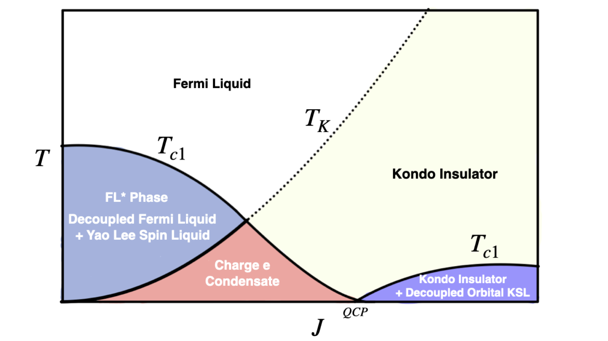
Itinerant electrons + spin liquid – phase diagram
Between the small FS phase (conduction electrons are decoupled) and large FS (spins are incorporated into the band),
there is an exotic fractionalized SC phase.
T
0

Slide 17
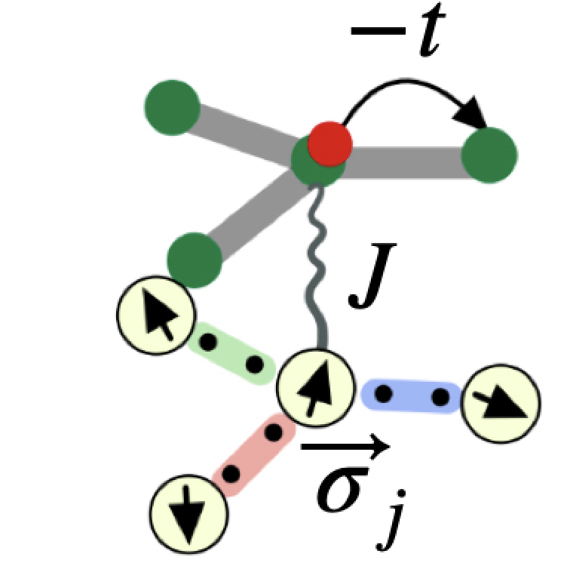
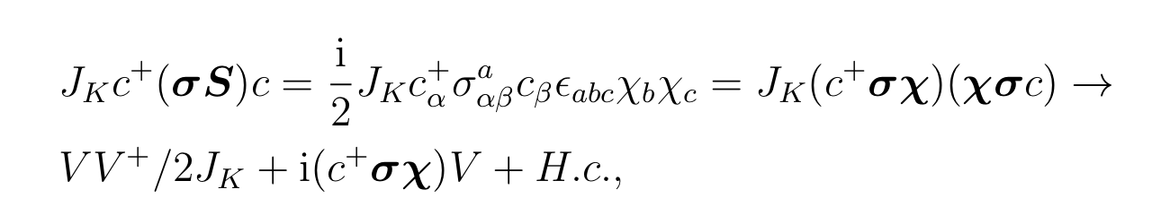
The Kondo lattice: itinerant electrons interact with spins
H = H_{SL} + t Σ [C⁺ (i) C(j) + H.c.] + J_{K} C_{α}⁺ (i)σ_{αβ} C_{β}(i) S(i),
Electrons which carry spin-1/2 and charge e interact with the spin liquid
which excitations are neutral fermions with spin 1.
The bound states of electrons and Majoranas carry spin-1/2 and charge e.
To express this mathematically we decouple the interaction with an auxiliary
field V_{α} which becomes order parameter when condenses:
J(σ_{αβ} Sª)c_{β} = V_{α} χª
.

Slide 18
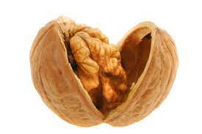
The results in a nutshell
Coleman, Panigrahi, Tsvelik 2022-2024
The essential ingredient - Yao-Lee spin liquid (solvable). Excitations - S=1 neutral (Majorana) fermions. The physical spin S=1/2 operator of this model is local in the Majoranas:
Sª = iε^{abc} χ_{b} χ_{c} /2
The exchange interaction with conduction electrons creates bound states of electrons and fractionalized excitations of the spin liquid. It dynamically generates a hybridization matrix element between conduction electrons (S=1/2) and the Majoranas:
J(σ_{αβ} Sª)ψ_{β} = V_{α} χª
This matrix element V_{α} - charge e, spin ½ boson –a fractionalized order parameter. This is superconductivity without pairing – a mechanism suggested by Coleman, Miranda and Tsvelik in 1994.
We found a 3D solvable example of such Kondo model.
Besides fractionalized order it displays rich physics including
Pair Density Wave
Odd-frequency pairing

Slide 20
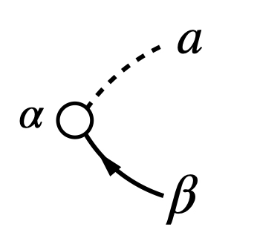
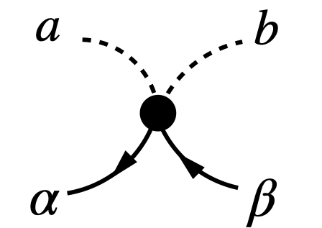
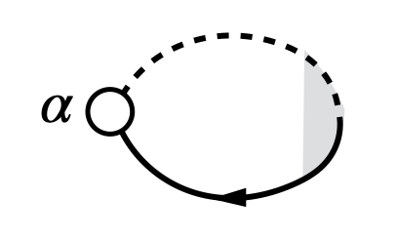
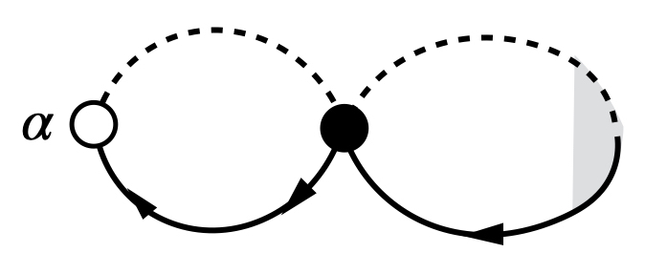
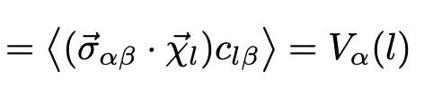
Since the Fermi surfaces of
Majoranas and electrons are congruent,
the electron-Majorana bubble diverges
logarithmically.
We collect the most divergent diagrams
as in BCS theory.

Slide 21
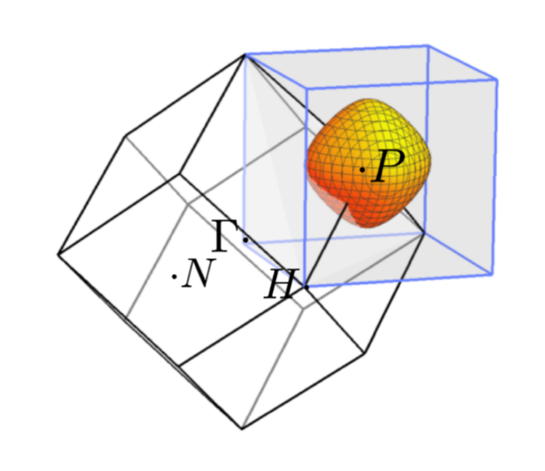
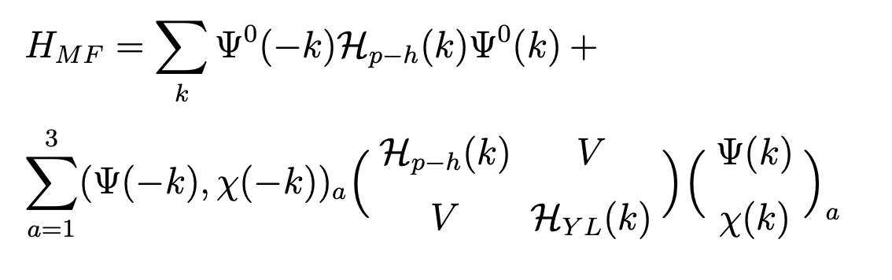
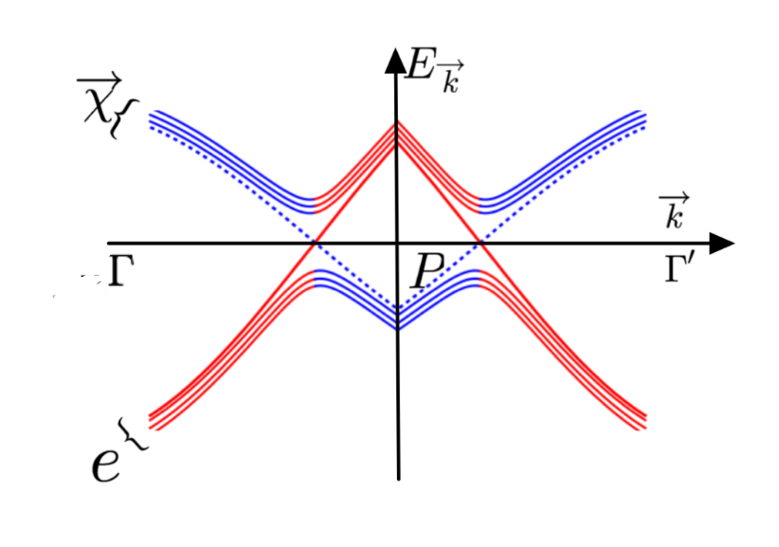
The ground state: V condenses
The particle-hole symmetric conduction band: 2 Dirac fermions (spin ½) = 4 Majoranas.
The Spin Liquid: 3 Majoranas.
Conclusion: one band Majorana mode is left unhybridized.
Below the phase transition 3 conduction modes+
3 Majorana modes become gapped.

Slide 22
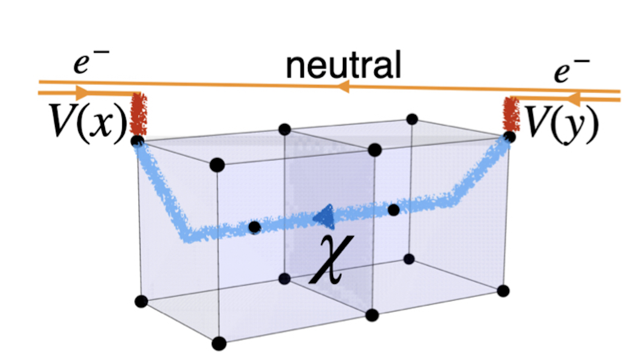
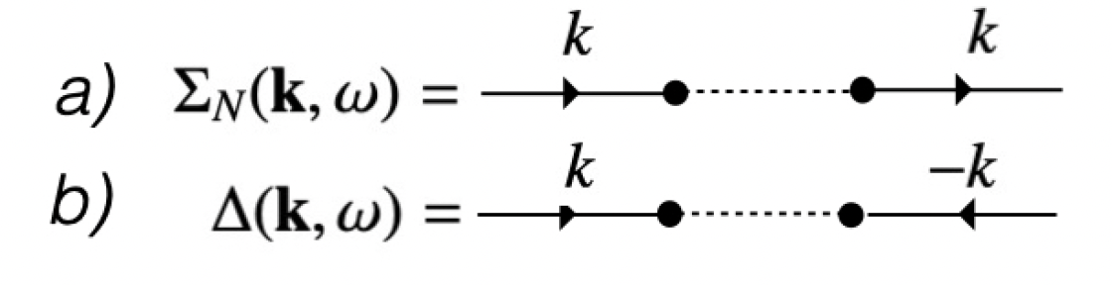
Electron enters the spin liquid, which excitations
are neutral S=1 fermions.
To enter it needs to leave its charge behind, that
is to deposit it in the condensate.
Since in the SL there is no difference between particles
and holes, the electron can emerge from it
either as a particle or a hole.
V
V⁺
V
V
From complex spinor V one can make 3 orthogonal unit vectors. They define gauge invariant electron self energy:
Vσ V⁺ = d₁ , iVσ_{y} σ V = d₂ +id₃
d’s are gauge invariant, but they are made of V’s
situated at different space-time points – fractionalization!

Slide 23
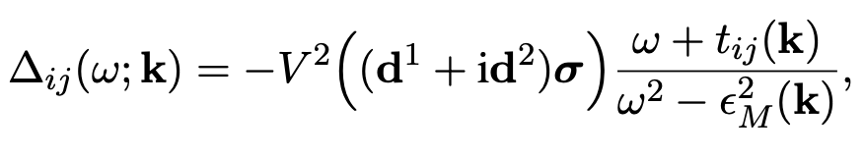
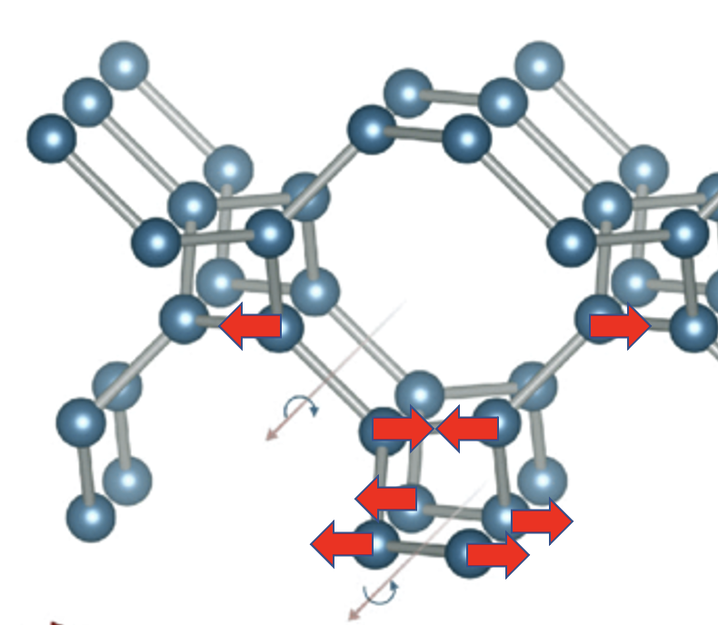
The anomalous part of the electron self energy: continued
So, what is it?
The gap function is a triplet, d₁ +id₂ breaks time-reversal symmetry,
These vectors alternate between sites of hyper-octagon lattice –
Pair Density Wave,
There is an odd-frequency piece,
There is a piece odd in k - t_{ij}
Pair Density Wave, odd-frequency pairing – these are believed to require
strong correlations, out of range of any perturbative approach.
Yes, they are, but we have taken the strong correlations into account –
EXACTLY!

Slide 24
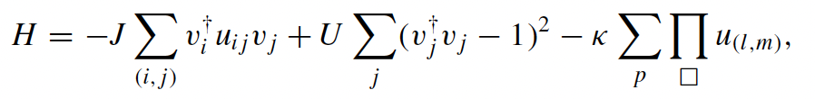
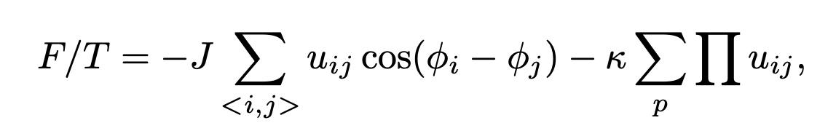
GL free energy. Confinement
Add Zeeman field which breaks SU(2) and the spinor V becomes a complex exponent.
Monte Carlo calculations of the
gyration radii for e^{2iφ} and e^{iφ}
fields show that the confinement
radius for the fractionalized order
Is finite, but anomalously high.

Slide 25
Conclusions
  Majorana fermions appear in many physical systems as collective excitations.
  I provided three examples: (i) 2-channel Kondo problem and (ii) exactly solvable spin liquids, (iii) an analytically treatable Kondo lattice model.
  The latter one describes a plethora of phenomena usually associated
  with strong correlations. All these phenomena (such as Pair Density Wave formation, odd-frequency pairing, order parameter fractionalization)
  are facilitated by the emergent gauge fields of the underlying Majorana spin liquid

Slide 27
Fractionalized order – the concept
Fractionalized excitations exist in low-D systems and in gauge field theories in higher dimensions.
Electrons may create bound states with emergent fractionalized excitations.
Fractionalized order emerges when these bound states condense.
Current example – a condensation of spin-1/2, charge e bosons in
a solvable model of 3D Kondo lattice.

Slide 28
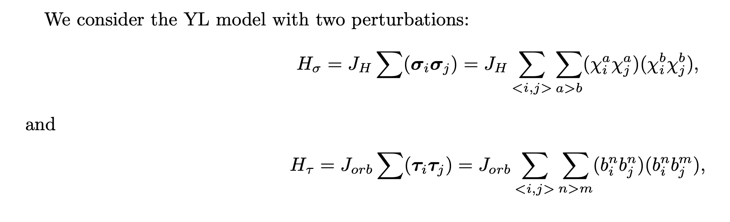
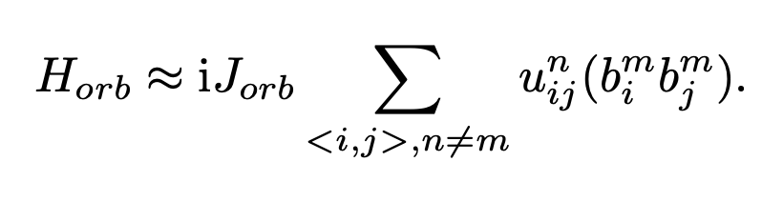

YL model – perturbations (new results)
The first one may lead to phase transition to magnetically ordered phase, otherwise it just modifies the dispersion
of Majoranas. The second one makes the Z₂ field dynamical:
The spectrum of b−fermions on a hexagonal lattice is
Once it remains gapped the static solution is stable.

Slide 29
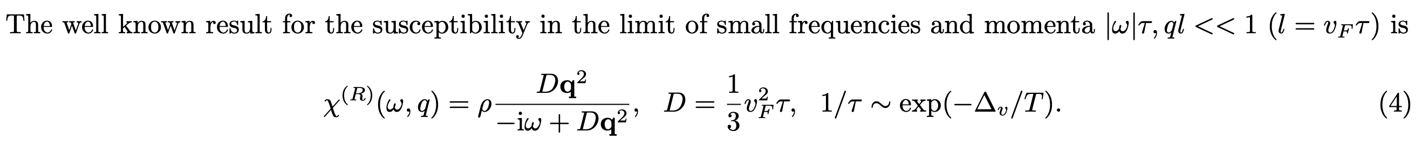
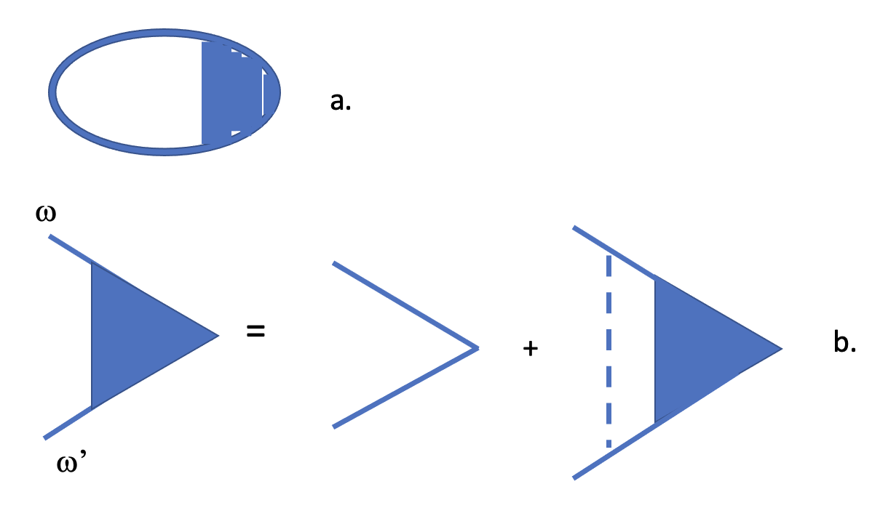
YL model: finite T
At finite T bond flips (vison pairs) act as resonant static scatterers.
The spin dynamics becomes diffusive:
Sª = iε^{abc} χ_{b} χ_{c} /2

Slide 30
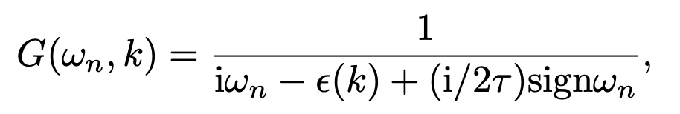
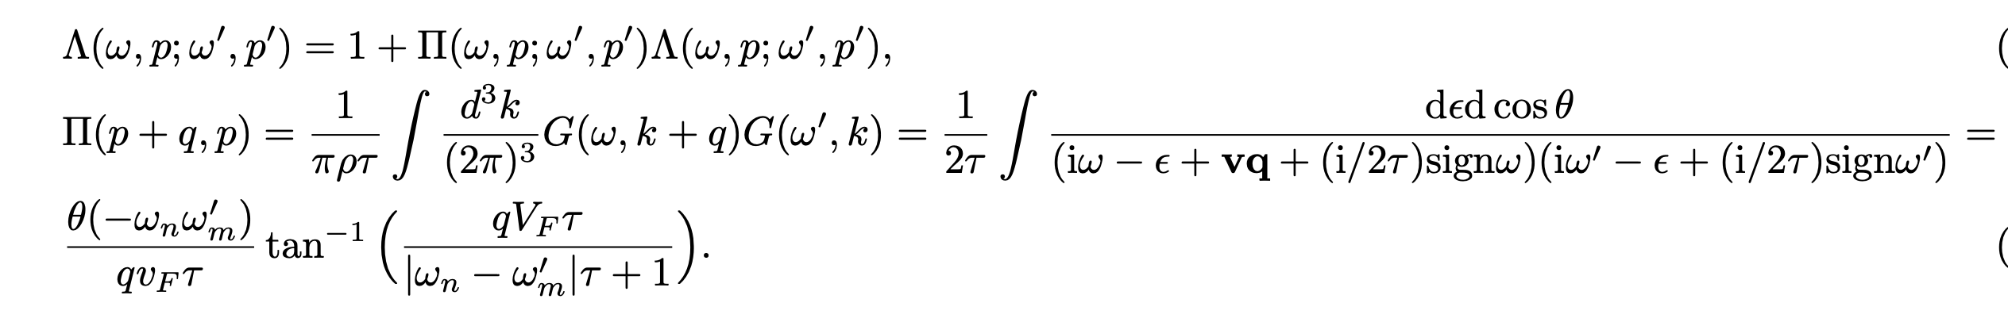
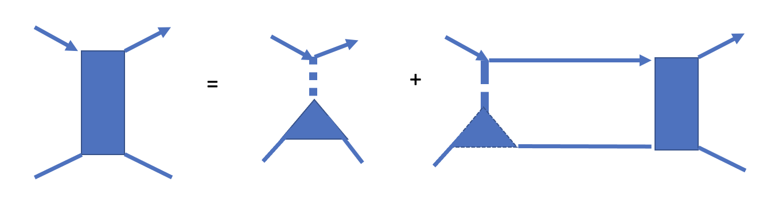
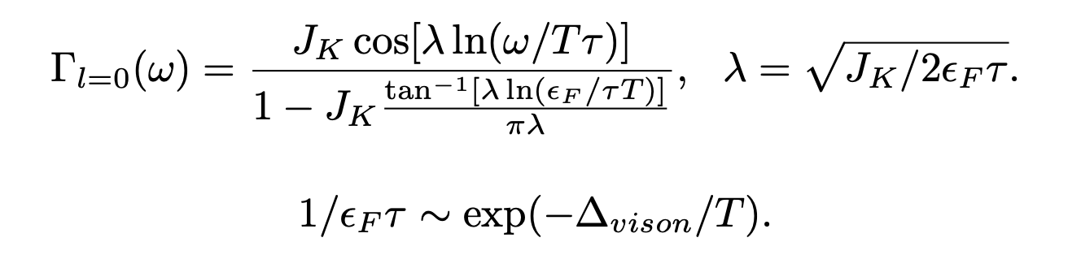
Finite temperatures
Gauge field fluxes act as static scatteres and can be treated as impurities.
We have to modify both the Majorana Green’s function and the interaction vertex.
The disorder generates two competing effects: a.) finite mean free path for the Majoranas and
b.) increase in the Kondo coupling. All those lead to insignificant corrections at small J_{K} .

Slide 31
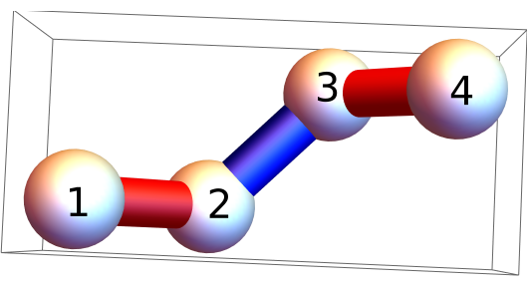
Spin liquid – the Yao-Lee model on hyper-octagonal lattice
We consider Yao-Lee model on hyper-octagonal lattice – 3D lattice with coordination number 3.
It is BCC lattice of (1,2,3,4) motives.

Slide 32
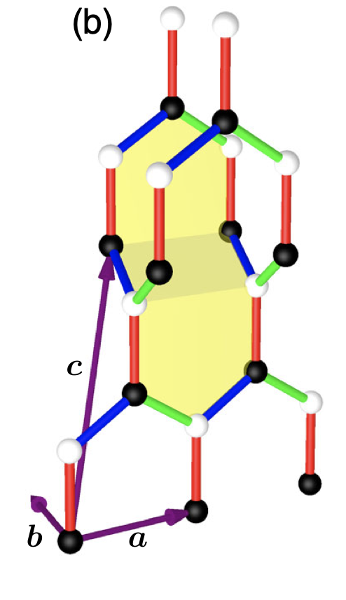
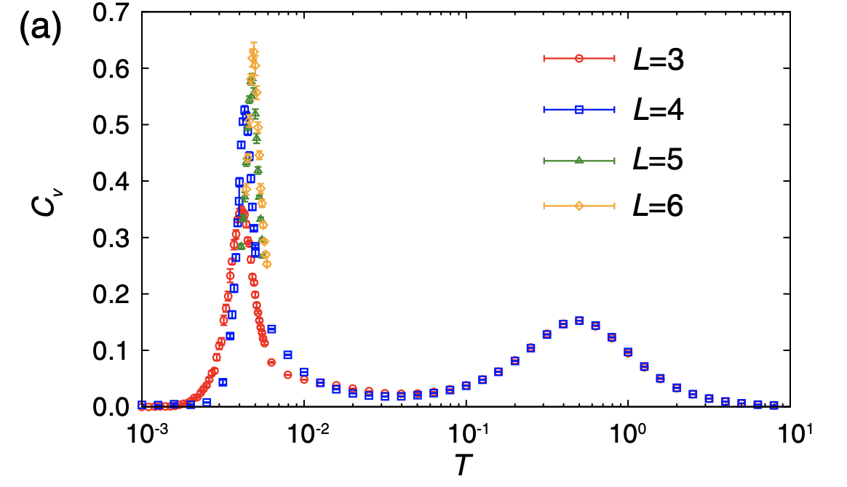
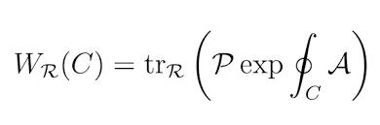
3D spin liquids: confinement of visons
In 3D fluxes cannot be treated as point- like objects.
Bond flips create fluxes through several adjacent plaquettes. At small T the visons are confined, above T_{c} they proliferate.
The phase transition from long to short loops.
Specific heat calculated by Monte Carlo:
evidence for phase transition at T =0.015J
J. Nasu et.al., PRL 113, 197205 (2014).
Example: hyper-honeycomb lattice

Slide 33
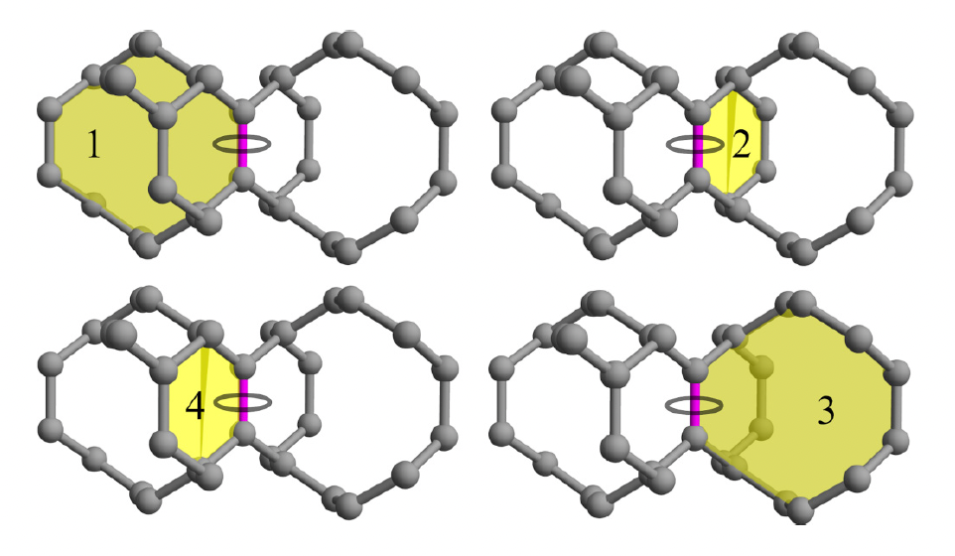
Visons in D=2 and D=3
…
+
+
+
+
In 2D the fluxes (visons) can be taken as far apart as one likes without incurring much energy. No confinement.
In 3D visons are confined.
By flipping a sign of one bond in 3D one creates fluxes through
the adjacent plaquettes. Multiplication of sign flips incurs energy ~ to the distance between the visons.

Slide 34
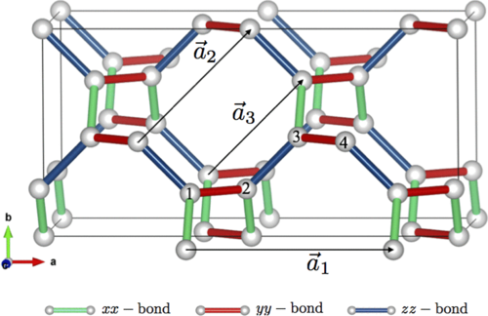
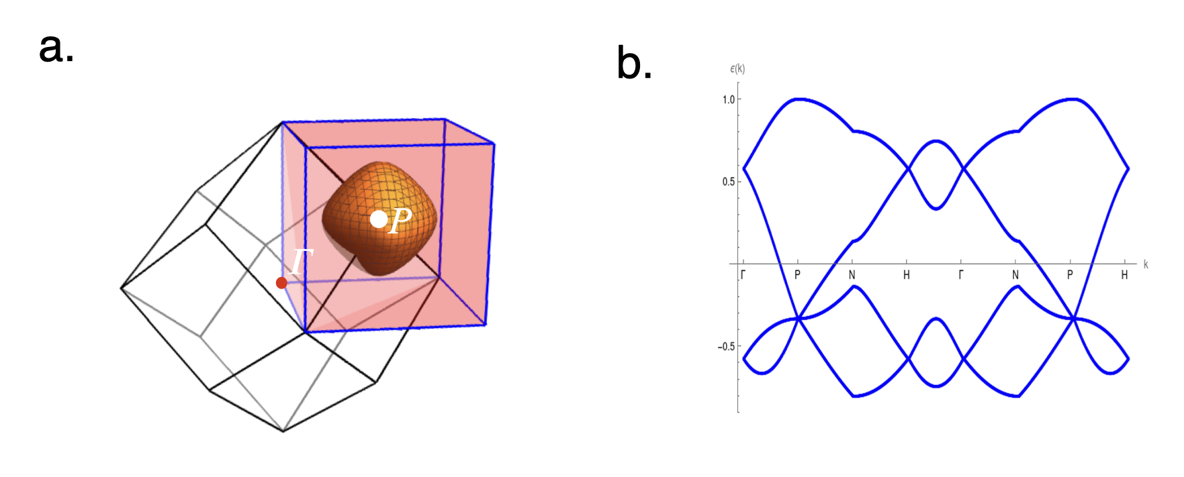
Continued: Yao-Lee on hyper-octagon lattice.
Spin liquid with a Majorana Fermi
surface.
Below T_{c} – it is like a metal,
but the carriers have no electric
charge.
M. Hermanns, S. Trebst, PRB 89, 235102 (2014)

Slide 35
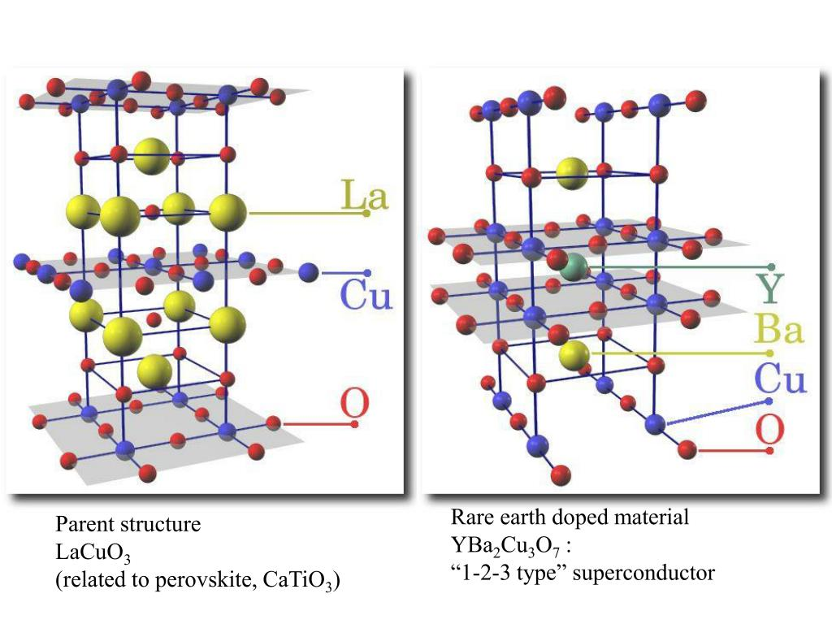

Paradox of Condensed Matter Physics
Simple systems – complex behavior.
Take one example – the cuprates
Strange metal
Pseudogap “phase”
Multiple orders including
Pair Density Wave
4. Stripes
5. Nematicity
The Hubbard model – does it
contain all necessary ingredients
to provide at least a qualitative
understanding?

Slide 36




Effects of visons on the order.
We investigated the 3D Z₂ gauged XY model which is a simplified version of the GL model for the ordered phase.
Results: a phase transition into 2e superconductivity, the e order has finite confinement radius at K = tanh κ < 0.5
L ~ exp[U(K,J)/T], U(Κ =0) = 7.7J
Charge e ?
Ψ=exp(iφ)

Slide 37

35 Years of Effort Since the Discovery of High-T_{c}
Simple ideas, ”simple” models which we cannot solve:
Resonance Valence Bonds (RVB),
Fractionalization – spinons, holons
Spin liquids…
Does it really work? For example, is such thing as fractionalization possible beyond 1D?
It has turned out very difficult to get reliable results even for the simplest model – the Hubbard one.
The reason? – Strong interactions.

Slide 38

Kitaev spin liquid and its derivatives- exactly solvable model SLs
The first example of exactly solvable model of spin liquid:
Kitaev honeycomb model.
Solved by expressing spin -1/2 operators
as bylinears of Majorana (real) fermions
Sª =ic₀ c_{a} , {c_{a} ,c_{b} } = δ_{ab} , c⁺ = c,
c₀ c₁ c₂ c₃ =1

Slide 39


Kitaev model: Majorana fermions + static Z₂ gauge field
H = iJΣ(C_{r} u_{r,r+x} C_{r+x} + C_{r} u_{r,r+y} C_{r+y} + C_{r} u_{r,r+z} C_{r+z} ),
u_{r,r+a} =iC_{a,r} C_{a,r+a} = 1 or -1 – Z₂ gauge field.
Excitations: fermions and static
gauge field fluxes (visons).

Slide 40
A little bit about Majoranas
In real space C_{i} = C_{i}⁺ . In momentum space this means that
C(-k) = C⁺ (k),
that is Majorana fermion occupies ½ of the Brillouin zone.
Alternatively, one can make particle-hole
transformation and make all energies positive
as on the figure.

