Slide 1
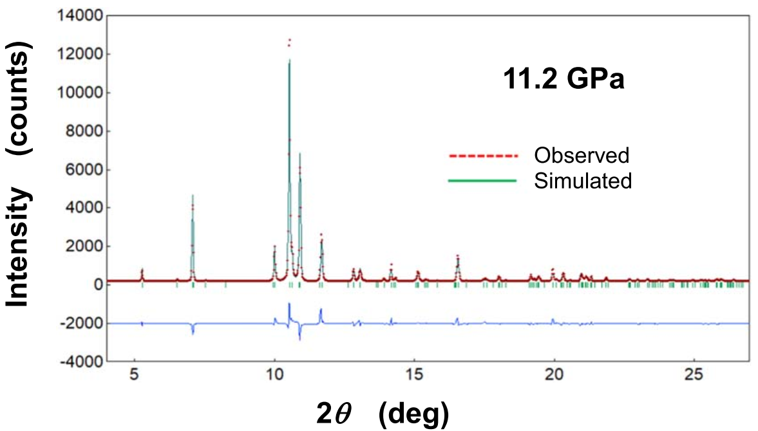
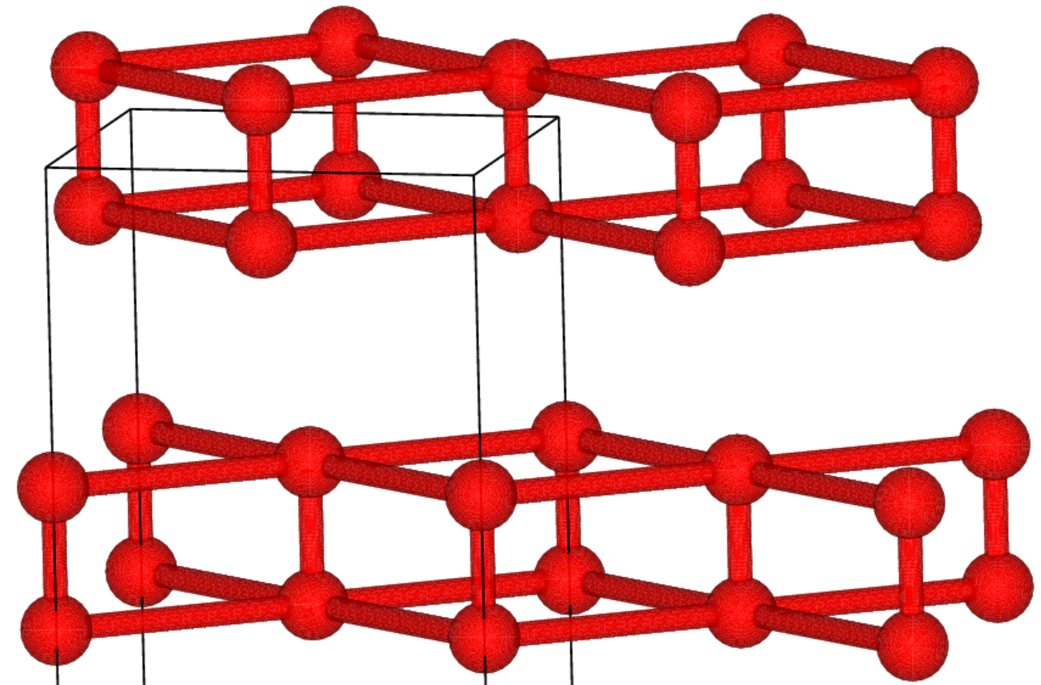
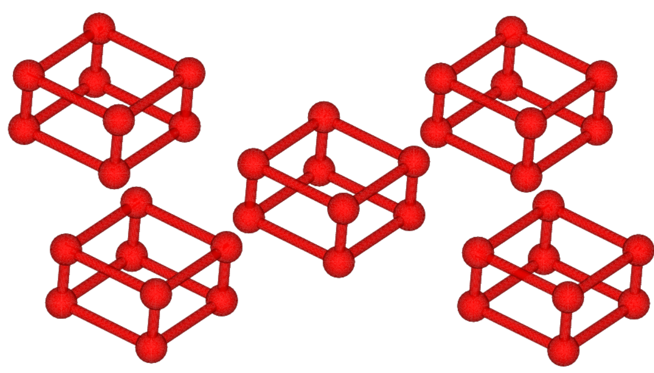
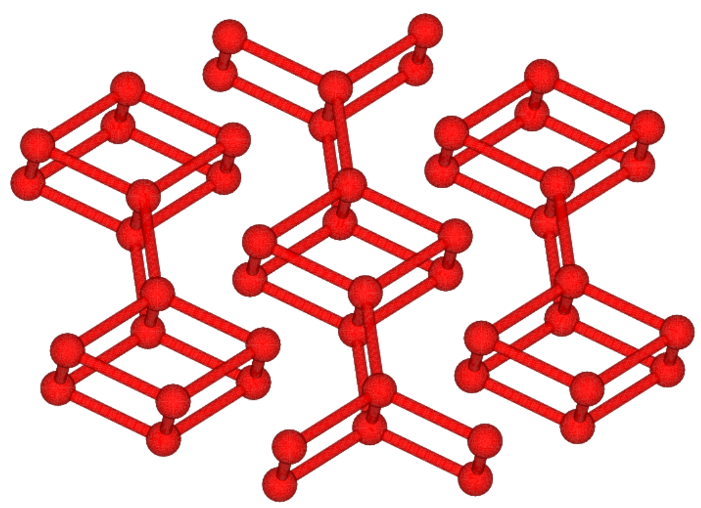
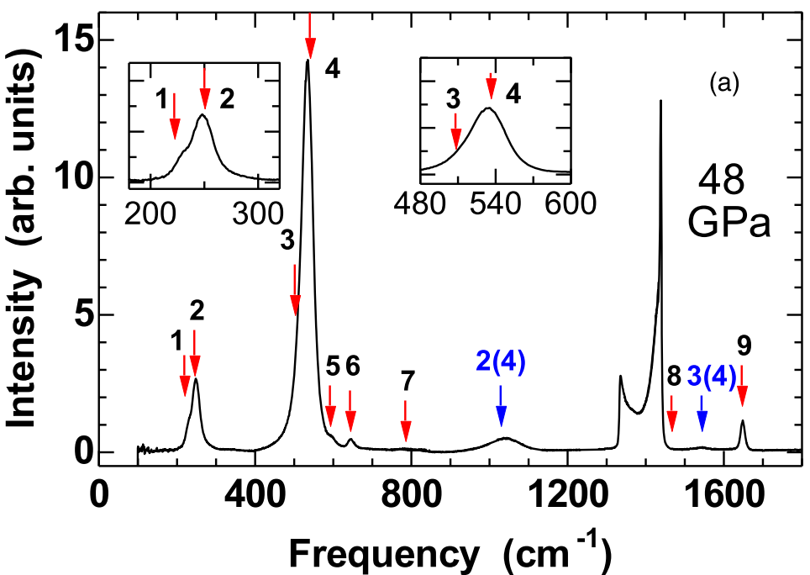
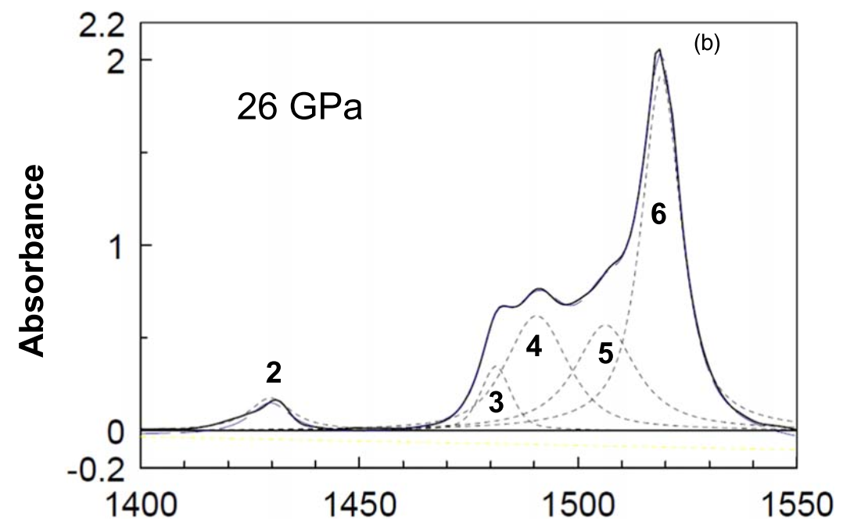
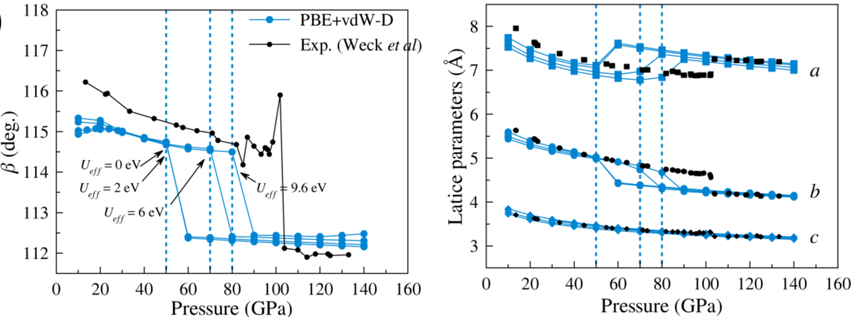
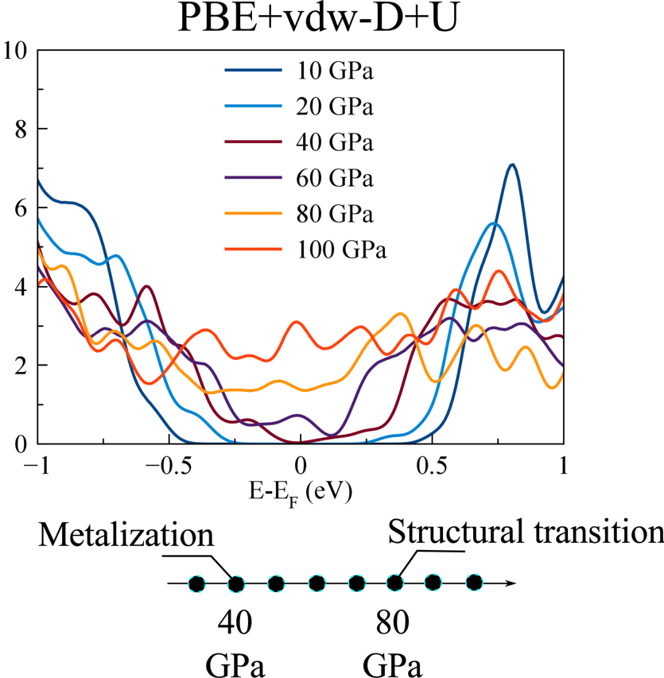
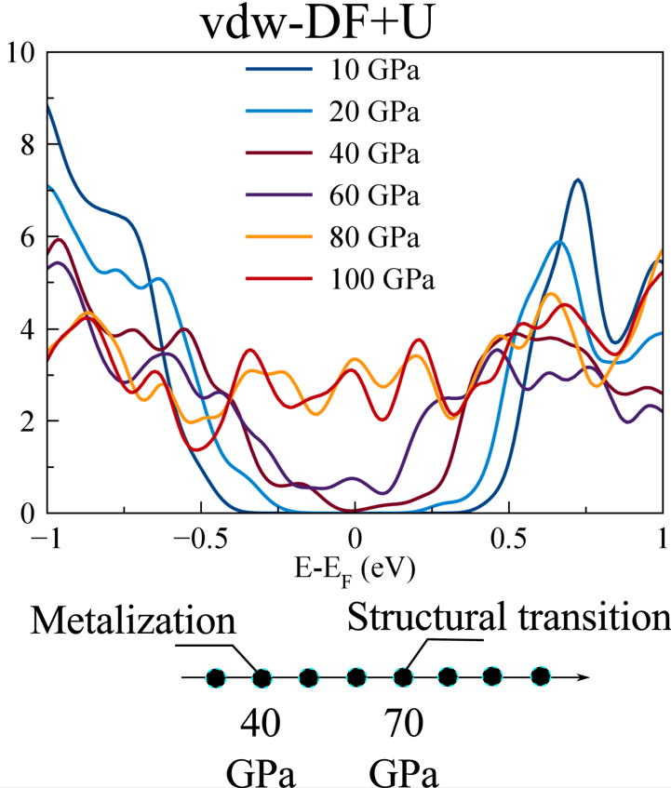
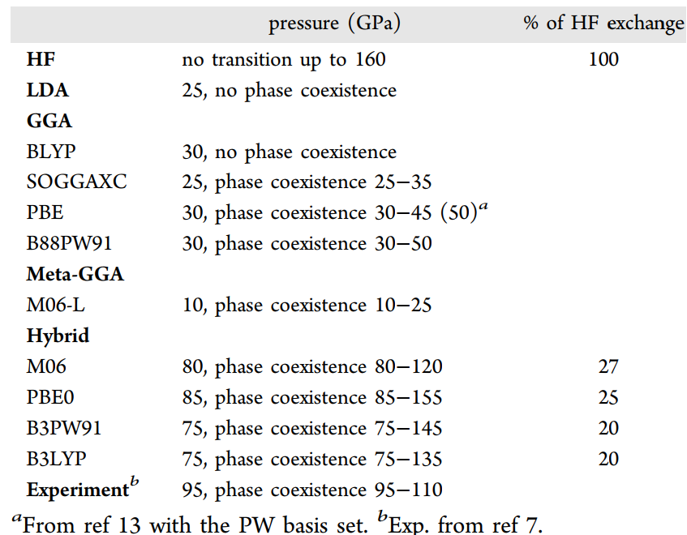
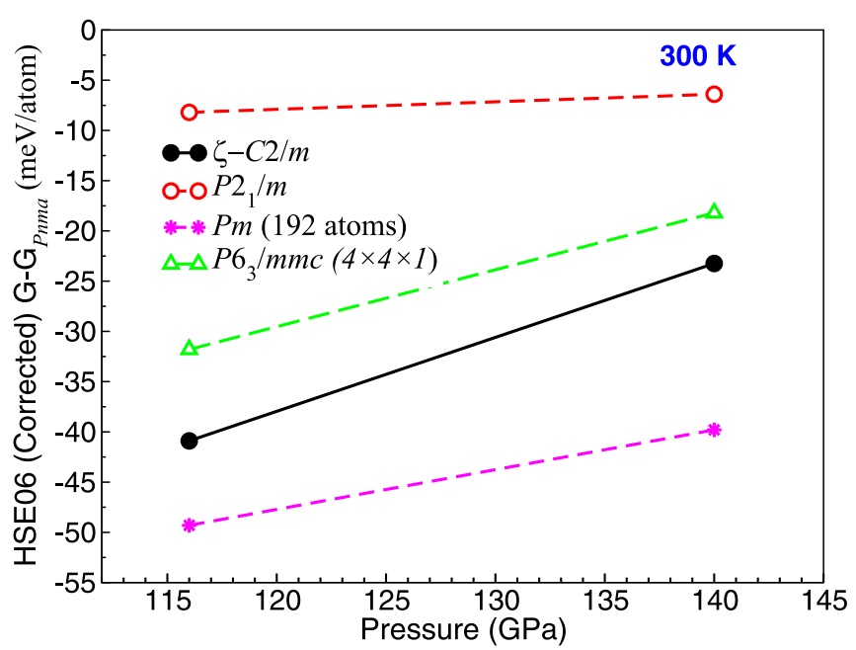
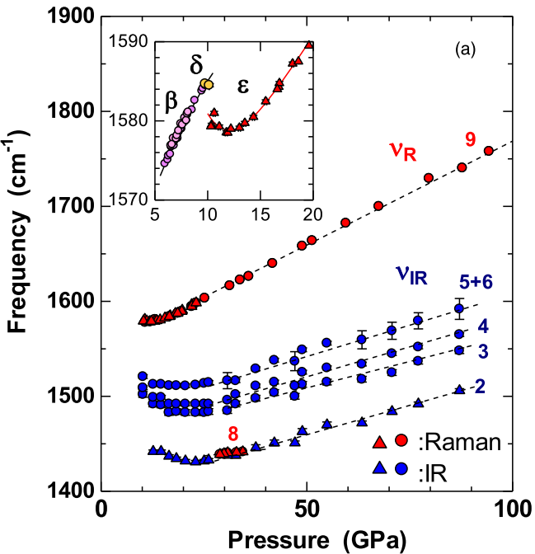
The Hubbard- and van der Waals-corrections on the DFT calculations of the epsilon-zeta transition in the solid oxygen
Le The Anh
Quemix Inc.
INTRODUCTION 1
INTRODUCTION 2
INTRODUCTION 3
High-pressure physics and strongly-correlated materials
Experimental methods to explore the structures
Theoretical physics of many-body systems
T (K)
1. Hartree-Fock
RT
$$E_{x}^{HF}≅−\frac{1}{2}\iint{d^{3}r_{1}d^{3}r_{2}\frac{φ_{n,k}^{∗}(r_{1})φ_{m,q}^{∗}(r_{2})φ_{n,k}(r_{2})φ_{m,q}(r_{1})}{\left|r_{1}−r_{2}\right|}}$$
$$ζ$$
C2h(C2/m)
2. Hubbard V
$$δ$$
Fmmm
$ε−$(O₂)₄
C2h(C2/m)
X-Ray diffraction
3. van-der-Waals
Semi-empirical
10
96
P (GPa)
$$E_{XC}^{vdW}=E_{X}^{GGA}+E_{C}^{disp}$$
Simplified phase diagram of solid oxygen
$$E_{C}^{disp}=C_{6}\frac{1}{{\left|R_{A}−R_{B}\right|}^{6}}+C_{8}\frac{1}{{\left|R_{A}−R_{B}\right|}^{8}}+…$$
Raman
IR absorption
Fully ab-initio
Yuichi Akahama et al 2019 Jpn. J. Appl. Phys. 58 095502
+U vs +U+vdW: Structure
Metallization vs Structural transition
PBE+U
PBE+U+vdW-D
vdW-DF+U
Phys. Chem. Chem. Phys., 2023,25, 25654-25658
Phys. Chem. Chem. Phys., 2023,25, 25654-25658
Hartree-Fock physics
Un-solved problems
DFT
Exp.
Zeta phase: Pm symmetry has lower enthalpy than C2/m
C2h(C2/m): 12 Raman + 9 IR
D2h: 9 Raman + 6 IR
B3LYP also predicted the co-existence of the epsilon and zeta phases.
PRB 2024 110, 064106
Jpn. J. Appl. Phys. 2019 58, 095502
J. Chem. Theory Comput. 2015, 11, 3, 1195–1205
Summary
Summary
Possible long-range treatments are:
Hartree-Fock exchange
Inter-site Hubbard +V
van-der-Waals
Within the two-body correlation approximation.
High pressure phases of solid oxygen are complex.
It requires both correct short-range and long-range treatments on the equal footing.

